Slide 1
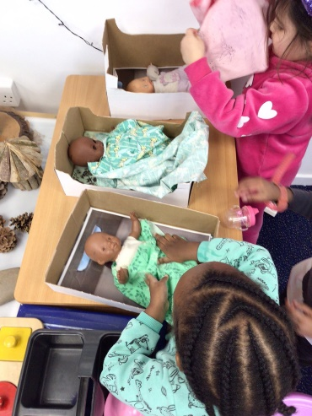
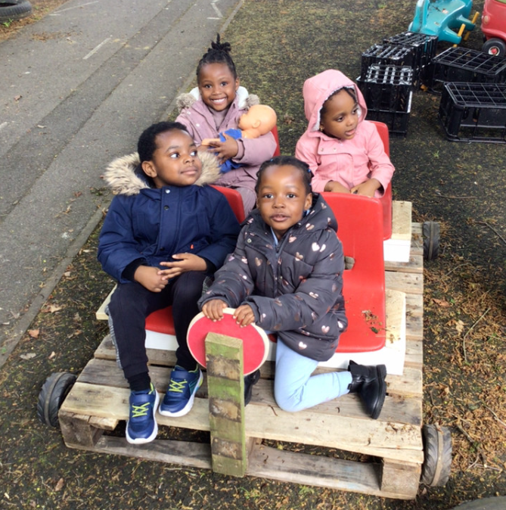
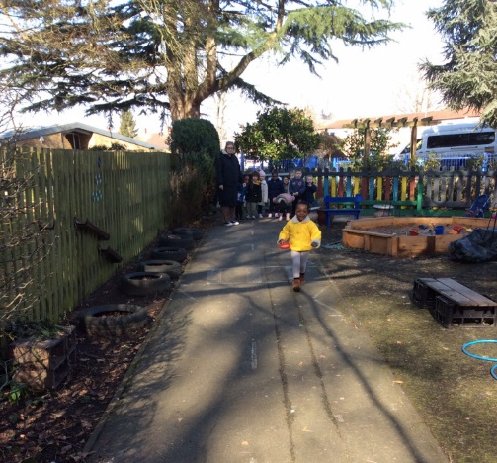

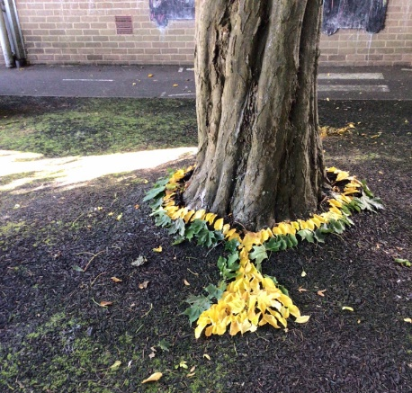
Parents’ Information
For children who are starting at our Pre- school in September 2025
We are very excited that you and your child will be joining our
Good Shepherd Family in September.
We hope this short presentation will help to give you a feel of our wonderful school.
“Following Jesus, The Good Shepherd, in all we say and do."

Slide 2

Prayer
Heavenly Father,
Thank you for the gift of our new families.
Thank you for the gift of love, of life, and of community.
Lord, we trust you with everything in our lives and our most precious gift: our children and family.
As we prepare for the new school year ahead, we pray for our new children as they prepare for a year of learning and become part of our Good Shepherd family.
We pray that in all that they do they will be guided by you and by your Holy Church. We pray that we all follow
'Following Jesus, The Good Shepherd, in all we say and do’.
Amen

Slide 3

Our School Video

Slide 4

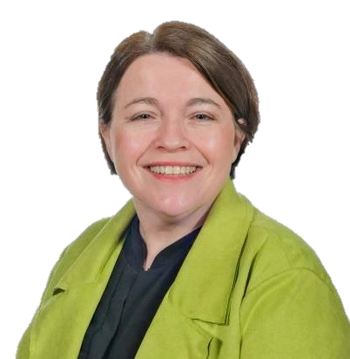
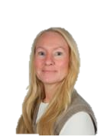
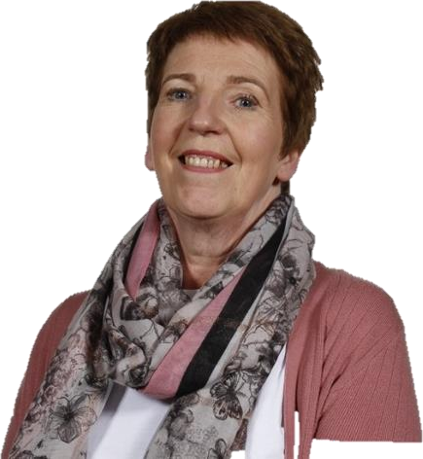
The Good Shepherd Team
I am Mrs Dodds the Headteacher
I am
Mrs Bonner the EYFS teacher
I am Mrs Thomas the SENCO
I am
Mrs Auburn the Family Support Worker

Slide 5
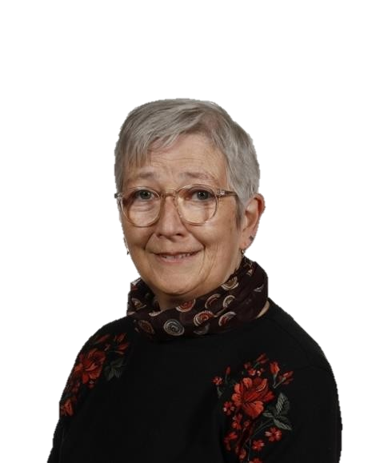



The Good Shepherd Team
I am
Mrs Broughton EYFS Key
Worker
I am
Mrs Hancy EYFS Key Worker & Chatterway Teacher
I am
Miss Amy the Office Manager
I am Miss Emma the Office Assistant

Slide 6


Slide 7

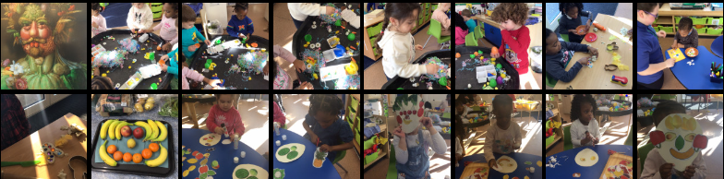
The Early Years Foundation Stage: Pre School
We build upon your child’s prior learning either from home with you, their parents or a previous setting. Parents are their child's first teacher and we value this.
We cover the seven areas of Learning using ‘Development Matters ‘ as our reference and have designed a broad and balanced curriculum. We share this with you both on our website and through weekly posts on Tapestry which is a secure online journal.
Your child will have learning opportunities both indoors and outdoors.

Slide 8

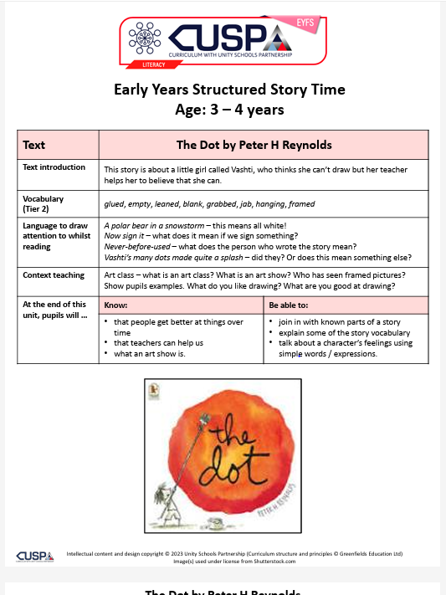

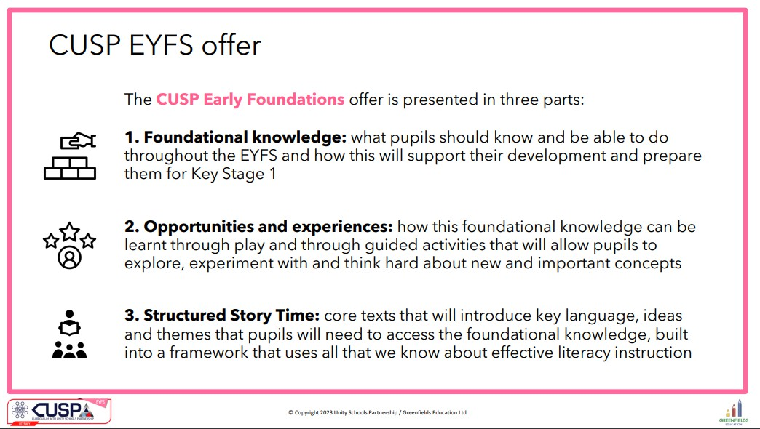
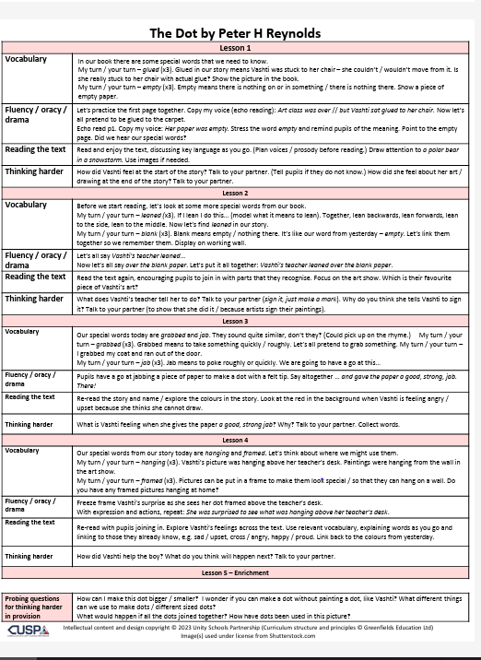

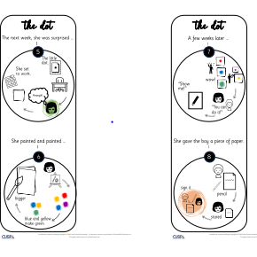
New Cusp Curriculum
TGS is a CUSP Curriculum School.
Our current EYFS curriculum is enhanced by quality texts which follows the Structured Story Time approach.
We will be incorporating CUSP texts into our Pre-School curriculum from September.
We use WRInc. To teach systematic synthetic phonics.

Slide 9
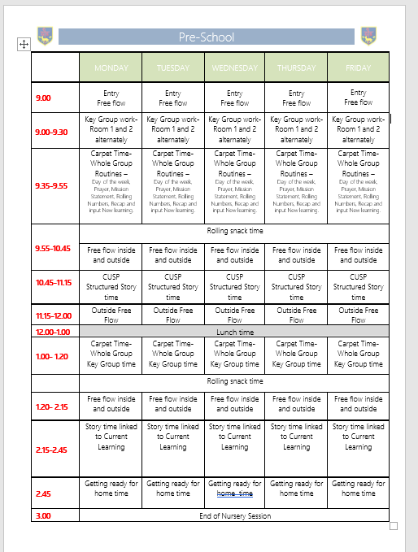
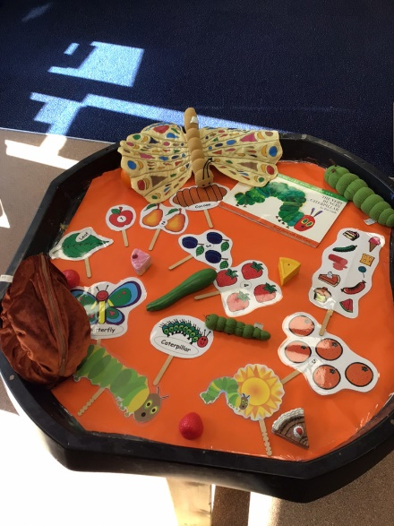
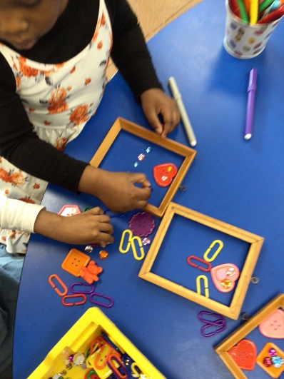
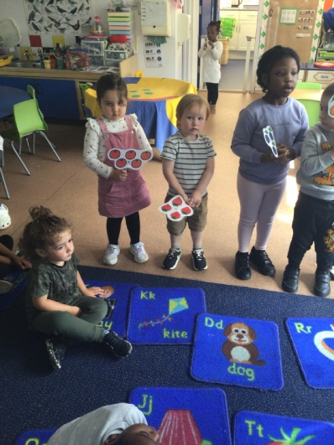
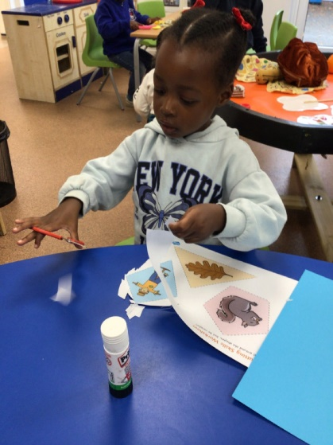
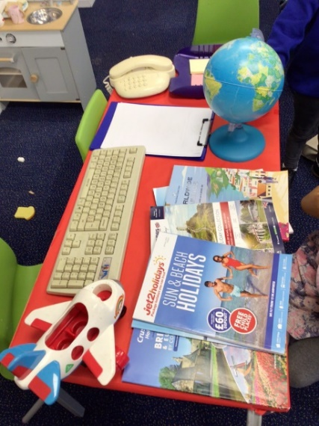

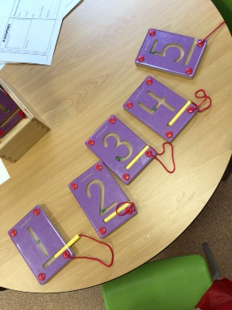
A typical week in the life of a Pre-School Child at
The Good Shepherd Catholic Primary School…

Slide 10
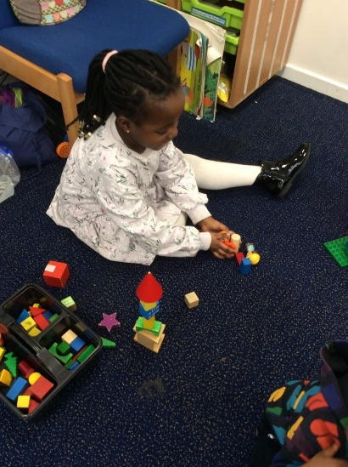
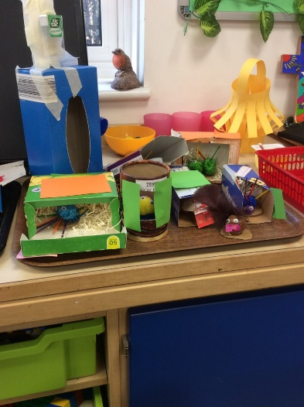
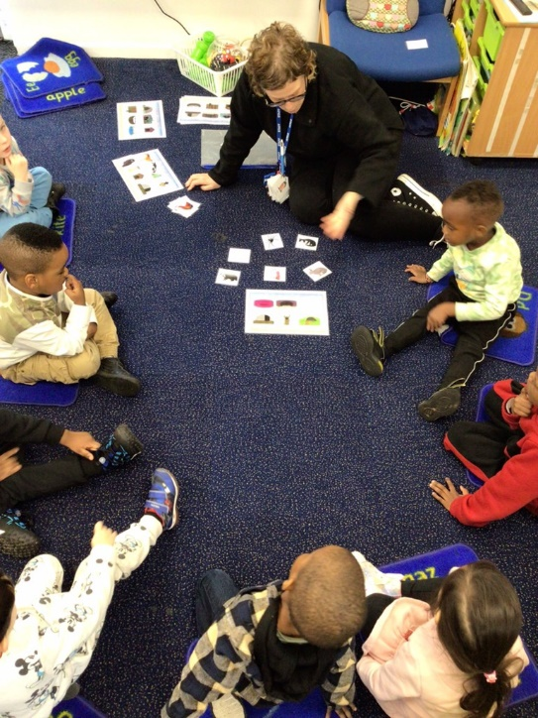
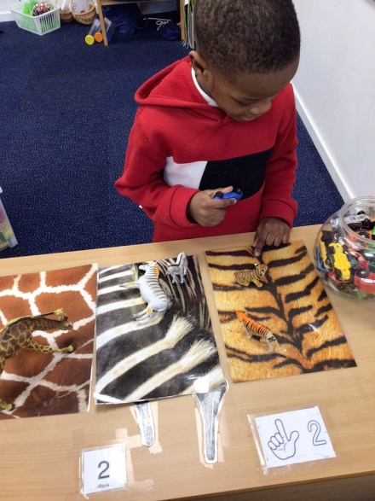

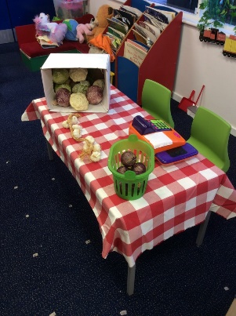
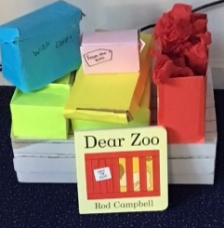
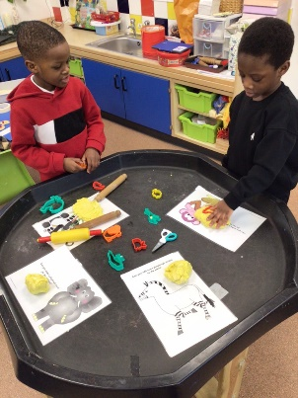
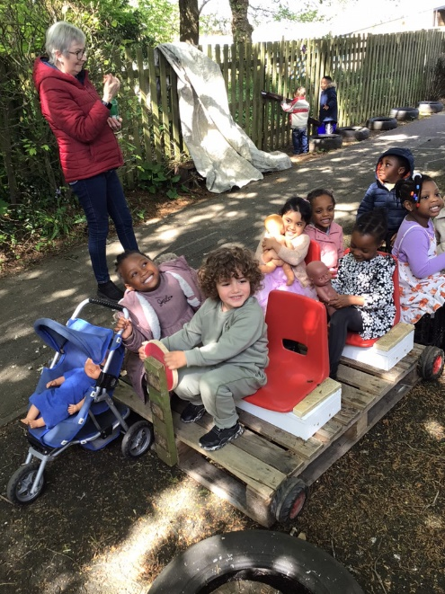
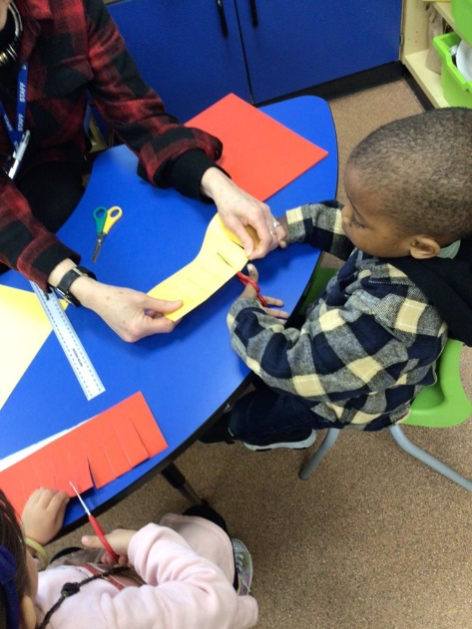

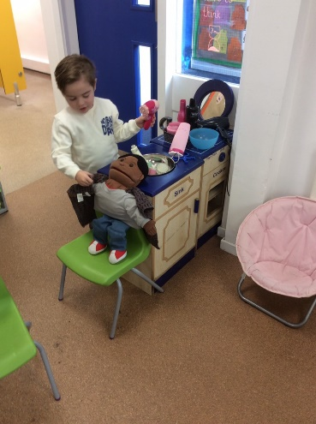
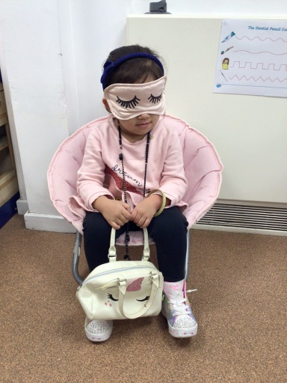
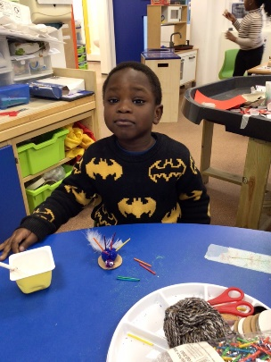
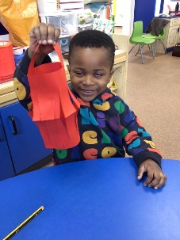
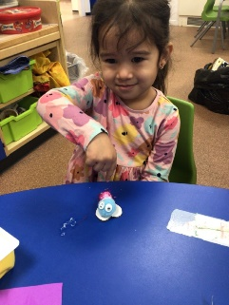
A typical week in the life of a Pre-School Child at
The Good Shepherd Catholic Primary School…

Slide 11
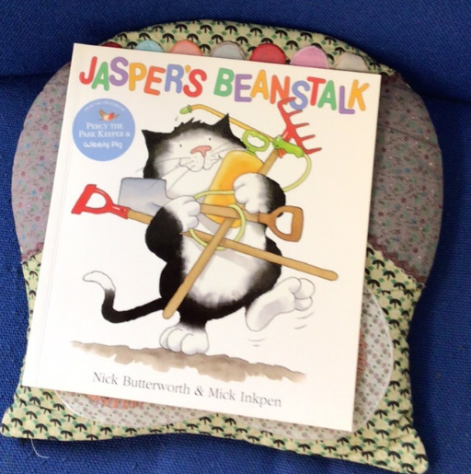
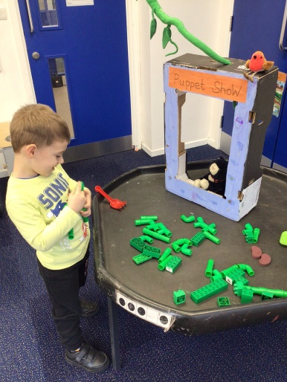
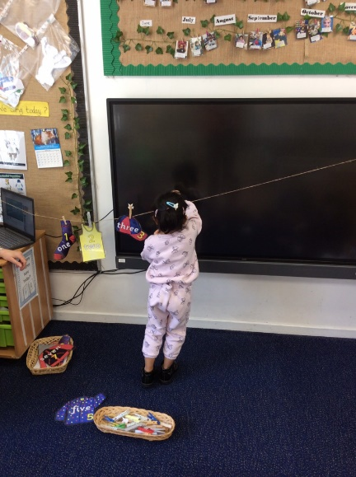
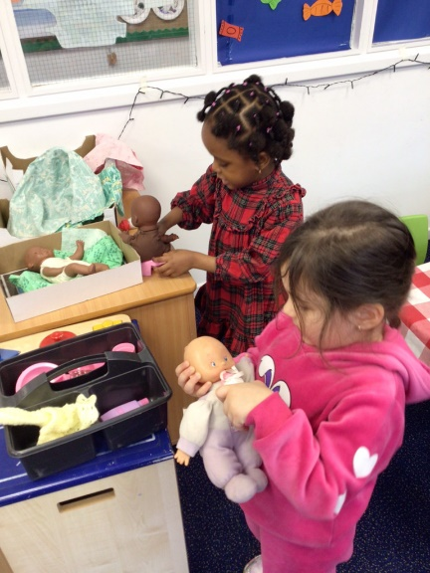
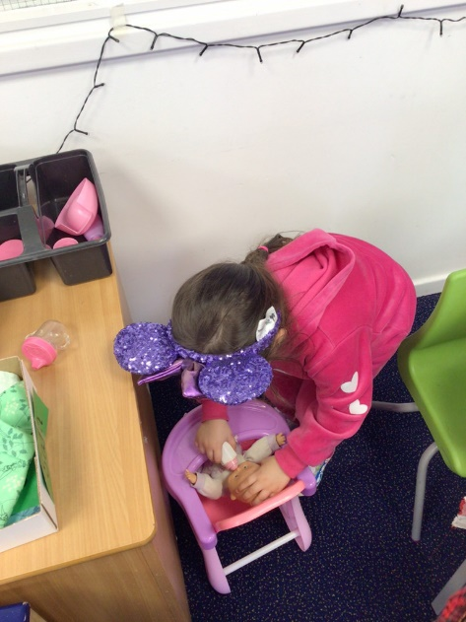
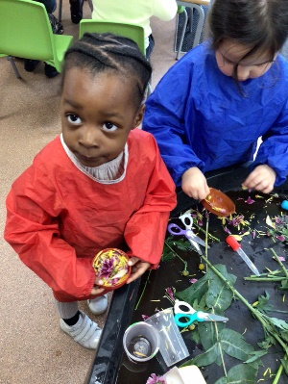
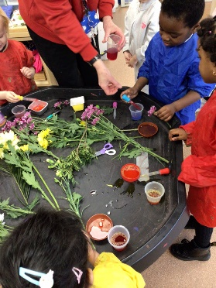
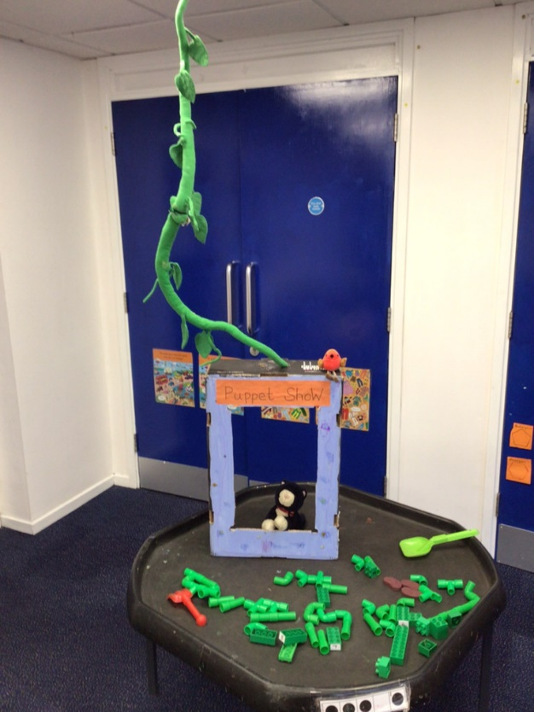
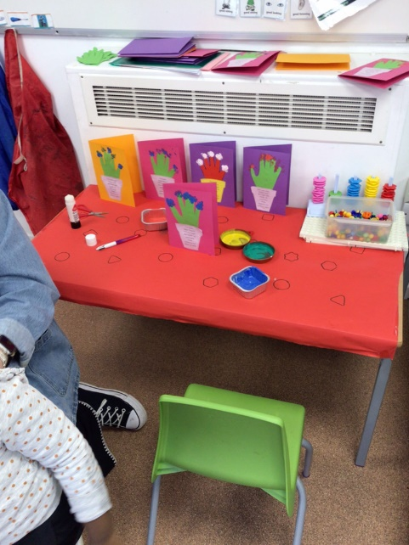
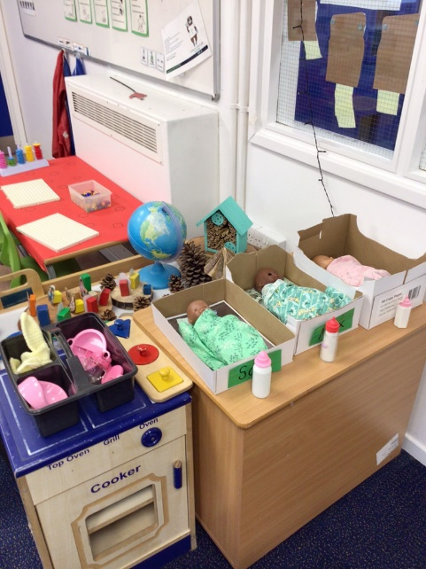

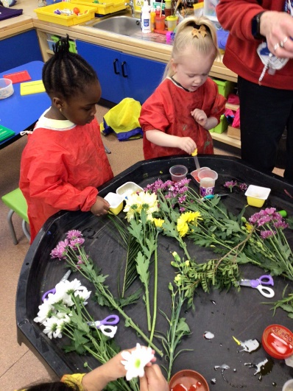
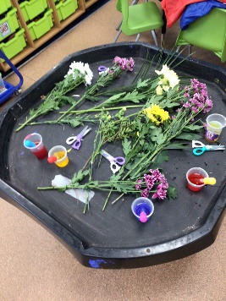
In Pre School we use books as a hook for our learning, exploring characters and situations. We have introduced a ‘Message Centre’, where children can build an excitement for mark making leading to early writing skills They can also engage in role play and small world activities which develops their speech and Language, as well as their social skills. We do explore sensory play, sand, water, playdough and gloop.

Slide 12


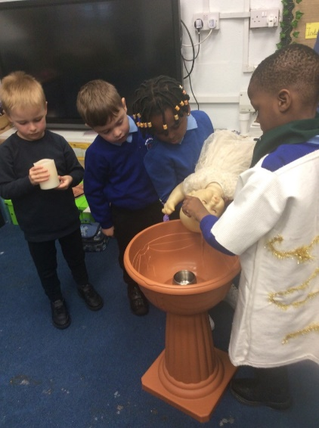
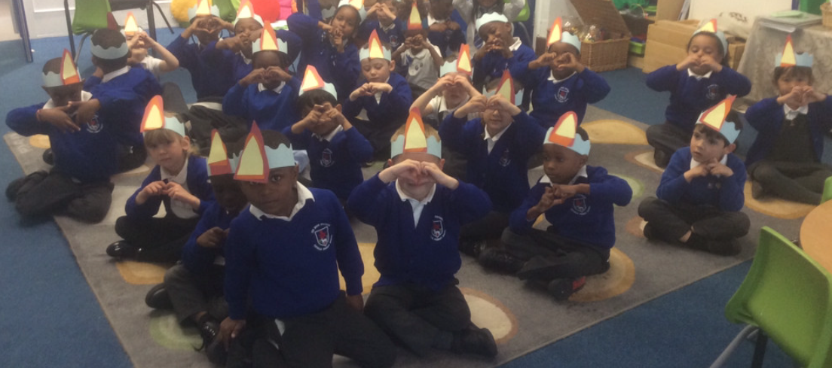

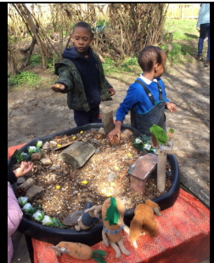
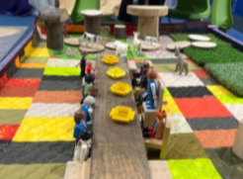





Our R.E. Scheme is called - RED, It has 6 Branches which are based on Scripture.
We have daily RE lessons where we learn about the Catholic Faith, Virtues to Live By, as well as learning about different Faiths and cultures.
Catholic Social Teaching produced by Cafod is
also very present with our school.
In Reception we explore Stewardship, the care of our world and everything in it.
Sofia the sloth is our character.

Slide 13
The 30hr Offer at TGS Pre-School
We offer 30 hour Funded places, this offer is dependent upon:
Your Childs Date of Birth- They must be 3 either on or before the 31st August 2025
Your child’s funding- You must be eligible for 30hr funding, you must have applied on the Government website and be in receipt of a DERN Number (Applications are open now). This must be shared with School when you return your child’s Admission Pack, before the deadline of July 13th 2025.
Apply now - https://www.westnorthants.gov.uk/get-help-paying-childcare/funded-early-education-and-childcare-3-and-4-year-olds/30-hours
Regularly reapplying for funding- You must regularly reapply for funding – every 3 months (we will inform you when your funding is nearing its end) you must share your new DERN number with the school. A failure to do so, will result in a withdrawal of your child's place.

Slide 14

The 30hr Offer at TGS Pre-School
Drop Off and Collection must be prompt. Doors open at 9.00am and close at 3.00pm - 6 hrs per day (Term Time Only).
Children must be provided with a health lunch and drink, in a named lunchbox and water bottle. (Please remember we are a nut free School).
There is an expectation that your child will be toilet trained before starting at our Pre School*. We do not have nappy changing areas.
Uniform - We do expect children to wear our school sweatshirt or cardigan
with a white polo shirt and black joggers/shorts.
Girls can wear a Blue and White Checked Summer dress in the warm weather or children can wear shorts. Children can wear black trainers or closed toe shoes.
Spare clothes in a named bag must be provided for any small accidents
Children should have appropriate outwear for the weather i.e. Gloves, hats, wellies and warm/waterproof coats in the Winter, sun hat in the Summer.
* Where there is no medical or other need preventing this.

Slide 15





Home-School Communication
We communicate with parents and carers in a range of different ways, this includes regular letters/e-mails home about important information and special events.
At The Good Shepherd Catholic Primary School we use My Child at School (MCAS), a service used by many schools and nurseries to communicate to parents.
Visit our school website – www.TheGoodShepherdCatholicPrimarySchool.org.uk for school information, news, dates for the diary, curriculum information, photo galleries, letters and much, much more!
Follow us on Facebook, Twitter and Instagram for regular school updates!
FACEBOOK: @TheGoodShepherdNorthampton TWITTER:@TGSNorthampton
INSTAGRAM: @goodshepherdnorthampton

Slide 16




Tapestry

Slide 17
Your Child’s Admission Pack
You will receive this today.
You will need to complete and return all the forms to the school office, including your DERN Number before the deadline Friday 13th July 2025.
You will also need to bring your child's Birth Certificate and passport into school before this deadline.
You will be invited in small groups to a play and stay session in our current Nursery over the next few weeks.
Once we have received your Admission Forms a start date will be allocated to your child. We do have a staggered start over the first week (2-8th September 2025)

Slide 18

Thank you for attending our
Parent Information Session today.

