Slide 1


30 days of 3 in 3
Mathematics
Commissioned by The PiXL Club Ltd.
February 2018
This resource is strictly for the use of member schools for as long as they remain members of The PiXL Club. It may not be copied, sold nor transferred to a third party or used by the school after membership ceases. Until such time it may be freely used within the member school.
All opinions and contributions are those of the authors. The contents of this resource are not connected with nor endorsed by any other company, organisation or institution.
© Copyright The PiXL Club Limited, 2018

Slide 2
Teachers’ Notes
The purpose of this resource is to provide Mathematics revision opportunities against the clock.
The intention is that pupils complete the 3 questions in 3 minutes.
The first 2 challenges model typical questions from the Arithmetic paper.
The third challenge is modelled on typical questions from the Reasoning paper (which can be answered quickly).
In addition to giving the solutions (which drop down in a fourth box), a discussion on the strategies used is advised. It is important that pupils develop quick decision making as to whether to solve the arithmetic questions mentally, with a few jottings or by using a standard written method.

Slide 3
Day 1
497 + 10 =
3. The time is 16:44. What time will it be in 23 minutes time?.
356 x 9 =
Solutions
1. 507
2. 3,204
3.17:07

Slide 4

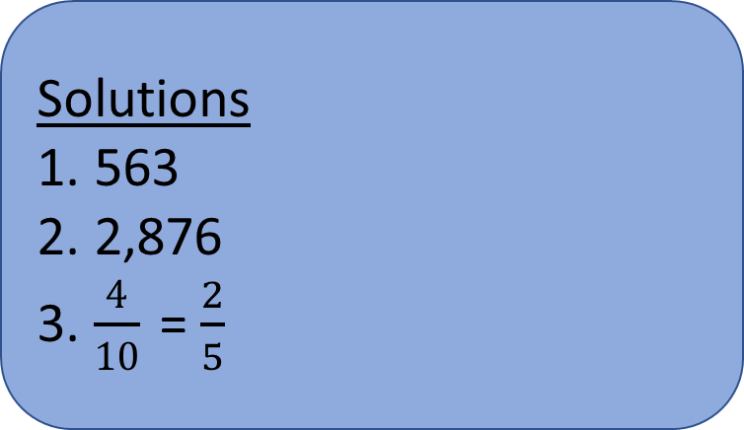
Day 2
3. How much of the diagram is shaded? Simplify your answer.
4,504 ÷ 8 =
3,876 – 1,000 =
Solutions
1. 563
2. 2,876
3. $\frac{4}{10}$ = $\frac{2}{5}$

Slide 5
Day 3
= 567 – 99
What is the difference between the two temperatures?
Moscow | London
-12°C | 8°C
15 – 5 x 9 =
Solutions
1. 468
2. -30
3. 20 degrees

Slide 6
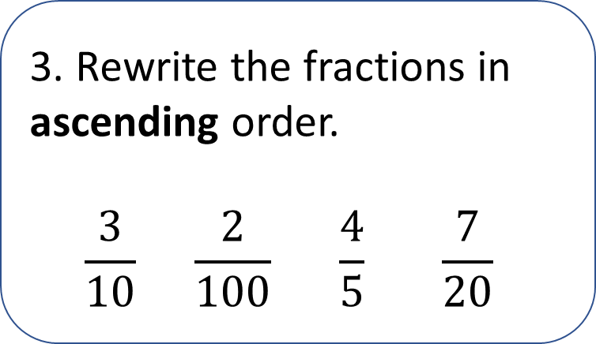
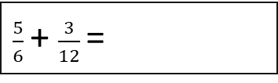
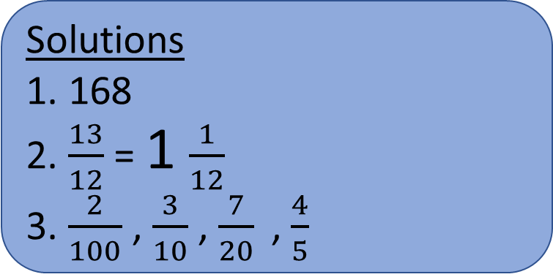
Day 4
42 x 4 =
3. Rewrite the fractions in ascending order.
$$\frac{3}{10} \frac{2}{100} \frac{4}{5} \frac{7}{20}$$
$\frac{5}{6}$ + $\frac{3}{12}$ =
Solutions
1. 168
2. $\frac{13}{12}$ = 1 $\frac{1}{12}$
3. $\frac{2}{100}$, $\frac{3}{10}$, $\frac{7}{20}$, $\frac{4}{5}$

Slide 7
Day 5
3. Ben says 1.4 x 1,000 is the same as 14 x 100. Do you agree? Yes or No. Explain your answer.
2,398 + 345 =
= 456 ÷ 10
Solutions
1. 2,743
2. 45.6
3. Yes. 1.4 x 1,000 = 1,400
14 x 100 = 1,400

Slide 8
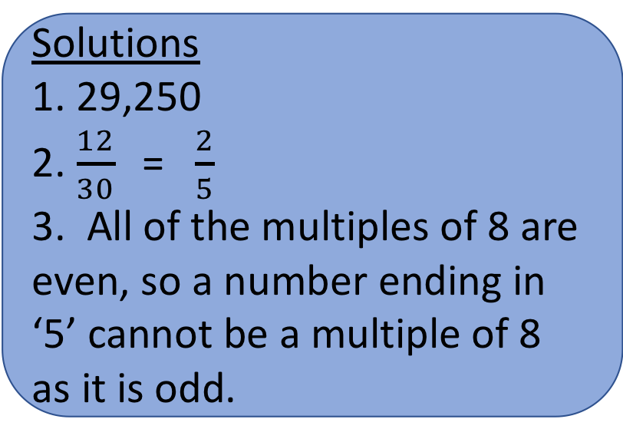
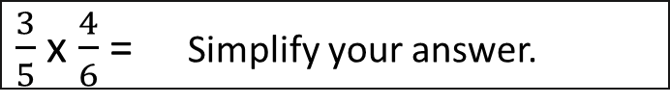
Day 6
30,000 – 750 =
3. Explain why a number which ends in ‘5’ cannot be a multiple of 8.
Solutions
1. 29,250
2. $\frac{12}{30}$ = $\frac{2}{5}$
3. All of the multiples of 8 are even, so a number ending in ‘5’ cannot be a multiple of 8 as it is odd.
$\frac{3}{5}$ x $\frac{4}{6}$ = Simplify your answer.

Slide 9
Day 7
6²+ 9² =
Write down the numbers which are common multiples of 3 and 8.
32 24 800 96 30
567 – 3.9 =
Solutions
1. 117
2. 563.1
3. 24, 96

Slide 10
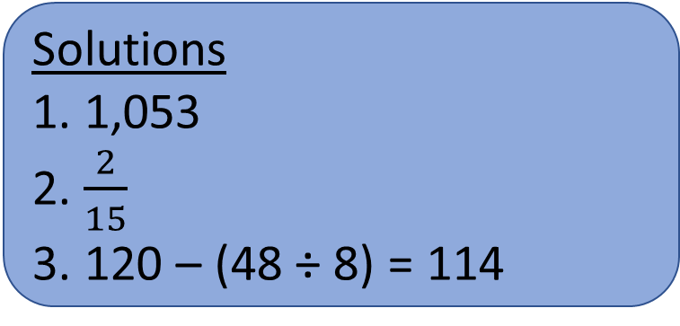
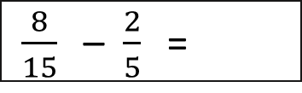
Day 8
234 x 4.5 =
3. Insert a pair of brackets to make the statement true.
120 – 48 ÷ 8 = 114
$\frac{8}{15}$ – $\frac{2}{5}$ =
Solutions
1. 1,053
2. $\frac{2}{15}$
3. 120 – (48 ÷ 8) = 114

Slide 11
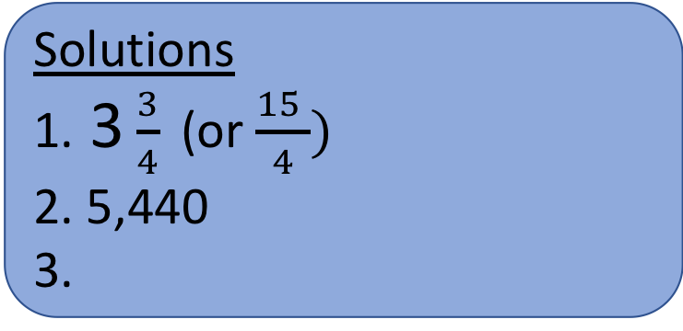
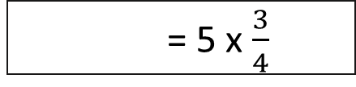
Day 9
3.
Use a card to complete each calculation.
3.5 = 35
3.5 = 0.035
3.5 = 350
X 10
X 100
X 1000
453 x 24 = 5 x $\frac{3}{4}$
÷ 10
÷ 100
÷ 1000
85 x 64 =
Solutions
1. 3 $\frac{3}{4}$(or $\frac{15 }{4})$
2. 5,440
3.
X 10
÷ 100
X 100

Slide 12
Day 10
20% x 350 =
3. Write down all the possible prime numbers which could make this statement true.
24 + < 36
34.567 – 4.9
Solutions
1. 70
2. 29.667
3. 2,3,5,7 and 11

Slide 13
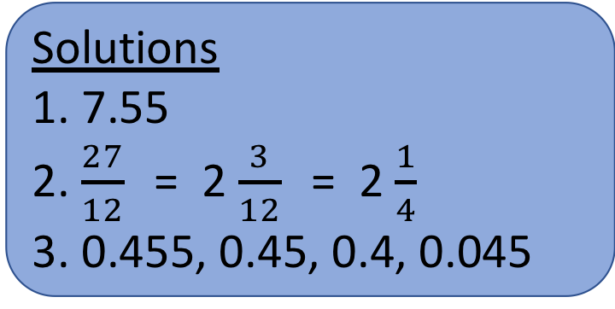
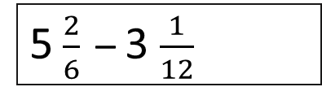
Day 11
8 – 0.45 =
3. Rewrite the numbers in descending order.
0.45 0.4 0.045 0.455
5 $\frac{2}{6}$– 3 $\frac{1}{12}$
Solutions
1. 7.55
2. $\frac{27}{12}$ = 2 $\frac{3}{12}$ = 2 $\frac{1}{4}$
3. 0.455, 0.45, 0.4, 0.045

Slide 14
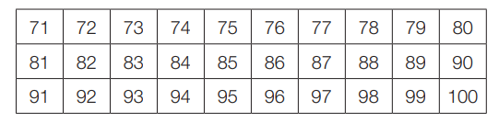
Day 12
3.
Write down the lowest common multiple of 3 and 5 in this table.
3,584 ÷ 14 =
= 15% of 440
Solutions
1. 256
2. 66
3. 75

Slide 15
Day 13
3. Use the symbols <, > or = to make each number sentence correct.
10% of 400 is 40
25% of 500 is 40
15% of 300 is 40
5% of 100 is 40
45.6 + 123.9 =
32,134 – 1,000 =
Solutions
1. 169.5
2. 31,134
3. = > > <

Slide 16
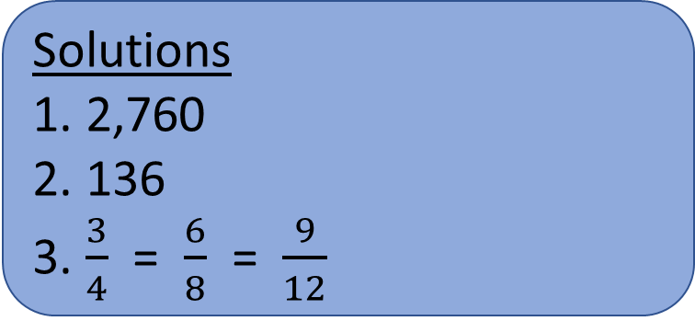
Day 14
345 x 8 =
3. Fill in the missing digits to make this fraction number sentence correct.
3 6
= 8 = 12
= 8² + (9 x 8)
Solutions
1. 2,760
2. 136
3. $\frac{3}{4}$ = $\frac{6}{8}$ = $\frac{9}{12}$

Slide 17
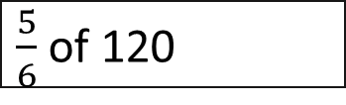
Day 15
720 ÷ 9 =
3. A model aeroplane is made to a scale of 1:100. If the model is 15 cm long, what is the length of the real aeroplane?
Give your answer in metres.
$\frac{5}{6}$ of 120
Solutions
1. 80
2. 100
3. 1,500cm = 15m

Slide 18
Day 16
3. Complete the table.
23,459 + 32,499
Number | Rounded to the nearest one | Rounded to the nearest 100
56.9
124.45
369.99
Solutions
1. 55,958
2. 698
3. 57,100; 124,100; 370,400
199 + 499 =

Slide 19
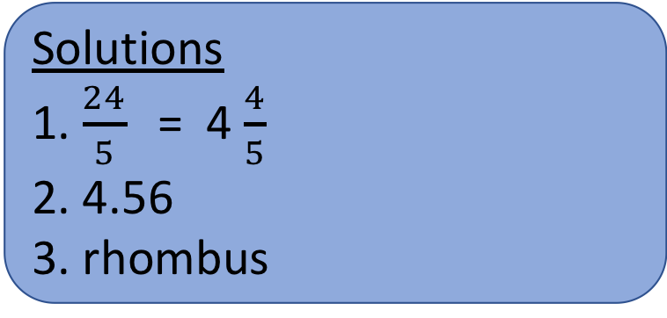
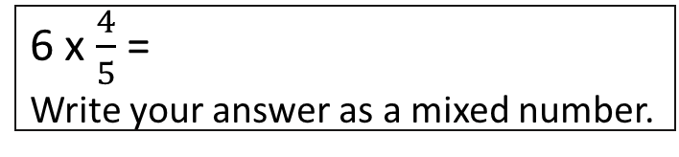
Day 17
3. Write down the name of the shape whose diagonals intersect at right angles.
6 x $\frac{4}{5}$ =
Write your answer as a mixed number.
456 ÷ 100 =
Solutions
1. $\frac{24}{5}$ = 4 $\frac{4}{5}$
2. 4.56
3. rhombus

Slide 20
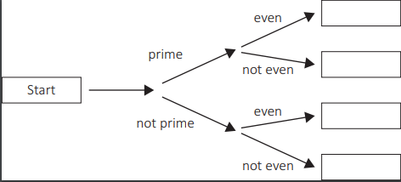
Day 18
3. Place each number below in the correct box in the diagram.
399 – 199 =
11 24 2 33
9,675 ÷ 15 =
Solutions
1. 200
2. 645
3. 2, 11, 24, 33

Slide 21
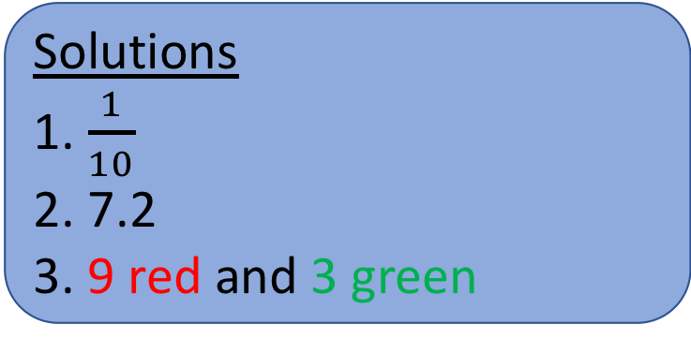
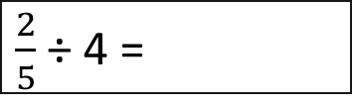
Day 19
3. Sketch the shape then colour (or label it) so the ratio of red to green is 3:1
$\frac{2}{5}$ ÷ 4 =
15% of 48 =
Solutions
1. $\frac{1}{10}$
2. 7.2
3. 9 red and 3 green

Slide 22
Day 20
32 x 4 =
3. Write the number that has six ones, 0 tenths and 5 hundredths.
4³ =
Solutions
1. 128
2. 64
3. 6.05

Slide 23
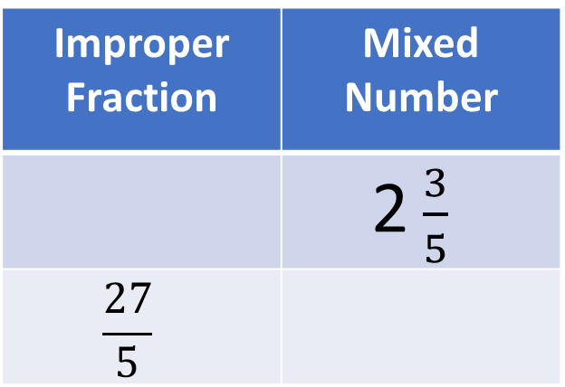
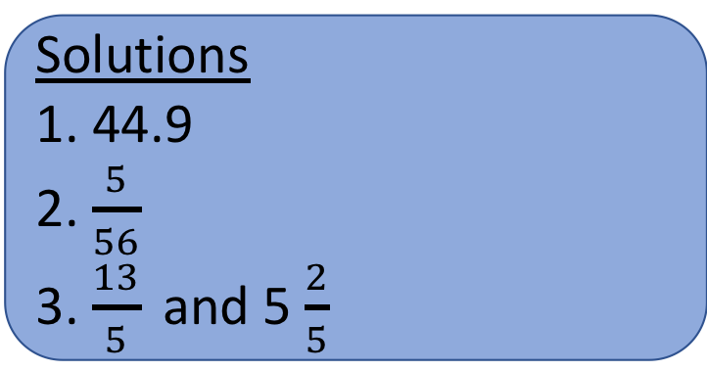
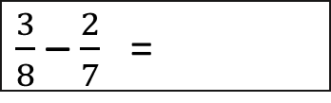
Day 21
3. Complete the table.
56.9 – 12 =
Improper Fraction | Mixed Number
 | 2 $\frac{3}{5}$
$$\frac{27}{5}$$
$\frac{3}{8}$ – $\frac{2}{7}$ =
Solutions
1. 44.9
2. $\frac{5}{56}$
3. $\frac{13}{5}$and 5 $\frac{2}{5}$

Slide 24
Day 22
= 34 x 45
3. Write down the number that is closest to 60.
60.1 59.91 60.001 59.09
3.04 x = 304
Solutions
1. 1,530
2. 100
3. 60.001

Slide 25
Day 23
3. Look at these numbers written in Roman numerals.
XIX M DCC LXX XV DX CCC
Write down all the numbers more than 500.
0.072 x 10 =
3.45 x 23 =
Solutions
1. 0.72
2. 79.35
3. M, DCC, DX

Slide 26
Day 24
3. Calculate the missing angle B.
B 24°
5² + 3³ =
96,432 ÷ 14 =
Solutions
1. 52
2. 6,888
3. 156°

Slide 27
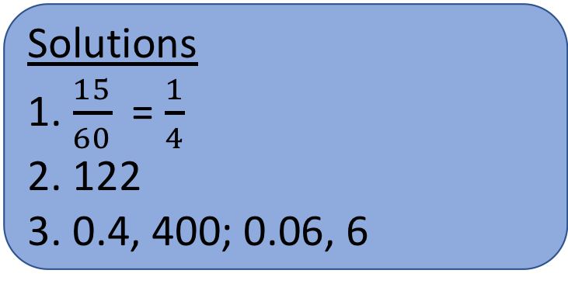
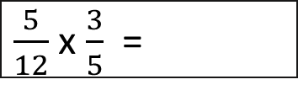
Day 25
3. Insert the missing numbers.
$\frac{5}{12}$ x $\frac{3}{5}$ =
 | x 10 | x 100 | x 1,000
 | 4 | 40
 | 0.6 |  | 60
128 – 36 ÷ 6 =
Solutions
1. $\frac{15}{60}$ = $\frac{1}{4}$
2. 122
3. 0.4, 400; 0.06, 6

Slide 28
Day 26
3. The perimeter of a regular hexagon is 120cm. What is the length of each side?
52 x 4 =
234 – 56.9 =
Solutions
1. 208
2. 177.1
3. 20cm

Slide 29
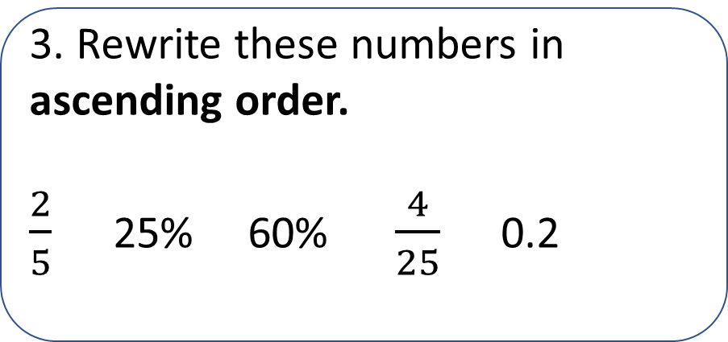
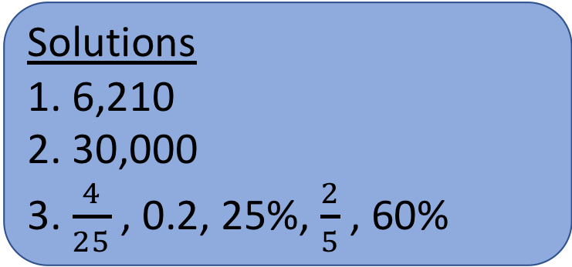
Day 27
345 x 18 =
3. Rewrite these numbers in ascending order.
$\frac{2}{5}$ 25% 60% $\frac{4}{25}$ 0.2
50 x 600 =
Solutions
1. 6,210
2. 30,000
3. $\frac{4}{25}$ , 0.2, 25%, $\frac{2}{5}$ , 60%

Slide 30
Day 28
3. Identify the missing numbers in these sequences.
4, 9, 15, , ,39
b) 12, 7, 2, , , - 13
0.004 x 1,000 =
= 864 ÷ 18
Solutions
1. 4
2. 48
3. a) 22, 30 (difference increases by 1 each time) b) -3, -8 (subtract 5 each time)

Slide 31
Day 29
3. If n = 7, match the answers to the correct expression.
6,098 + 300 =
n²
3.5
n -12
49
n ÷ 2
-5
546 - 359 =
Solutions
1. 6,398
2. 187
3. n² = 49; n -12 = -5;
n ÷ 2 = 3.5

Slide 32
Day 30
3. The volume of this cube is 27cm ³. What is the length of one edge? What is the area of one face?
40% of 360 =
32 x 4.5 =
Solutions
1. 144
2. 144
3. Length of edge= 3cm
Area of a face = 9cm²

