Slide 1


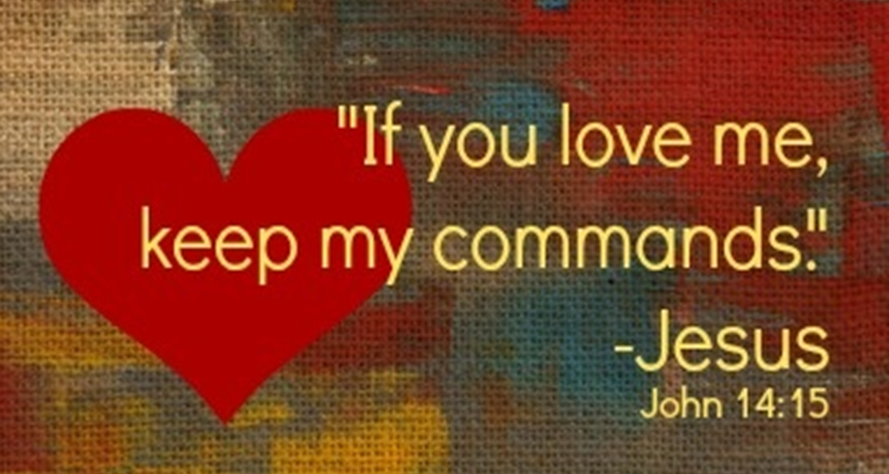




Gospel
The Sixth Sunday of Easter John 14:23-29
https://www.youtube.com/watch?v=DXDGE_lRI0E

Slide 2
A reading from the Holy Gospel
According to John (adapted)
Jesus said to his disciples:
‘If you love me, you will keep my commandments.
I shall ask the Father, and he will give you another Advocate to be with you for ever,
that Spirit of truth whom the world can never receive
since it neither sees nor knows him;
but you know him, because he is with you, he is in you.
I will not leave you orphans;
I will come back to you.
The Gospel of the Lord,
Praise to you, Lord Jesus Christ

Slide 3
Reflection
Jesus tells his friends that loving him means trying to follow his teachings, like being kind, helpful, forgiving, and loving others.
He promises that they will never be alone because God will send the Holy Spirit to help and guide them.
The Holy Spirit is sometimes called the “Advocate” or “Helper” because he gives us courage and comfort.
Jesus says, “I will not leave you orphans,” which means he will always care for us and stay close to us.
Even when we cannot see Jesus, we can feel his love through prayer, kindness, and the people around us.
We can try to listen to the Holy Spirit each day by making good choices and helping others.

Slide 4


Challenge:
Kindness Challenge:
Do one kind thing today without being asked — maybe share a toy, help a friend, or make someone smile.
Listening Challenge:
Spend one quiet minute talking to Jesus in your heart and asking the Holy Spirit to help you make good choices.
Love Like Jesus Challenge:
Use kind words all day today, even if something goes wrong.
Helping Hands Challenge:
Help someone at home or at school with a small job to show Jesus’ love.

Slide 5
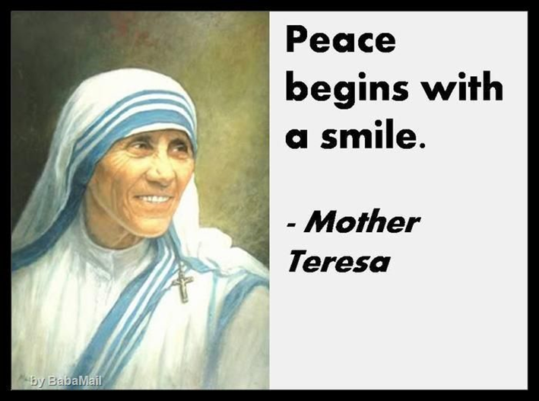

Slide 6

Dear Jesus,
thank you for loving us and always staying close to us.
Help us to follow your teachings and listen to the Holy Spirit every day, so that we can be kind and loving like you.
Amen.

