Slide 1

Gospel
The Sixth Sunday of Easter
John 14:15-21
https://www.youtube.com/watch?v=lFBZJGSgyVQ
https://www.youtube.com/watch?v=GuT7HI7ZvfA

Slide 2
Gospel
Jesus said to his disciples:
‘If you love me, you will keep my commandments.
I shall ask the Father, and he will give you another Advocate to be with you for ever,
that Spirit of truth whom the world can never receive
since it neither sees nor knows him;
but you know him, because he is with you, he is in you.
I will not leave you orphans;
I will come back to you.
In a short time, the world will no longer see me;
but you will see me, because I live and you will live.
On that day you will understand that
I am in my Father and you in me and I in you.
Anybody who receives my commandments and keeps them will be one who loves me; and anybody who loves me will be loved by my Father,
and I shall love him and show myself to him.’
John 14:15-21

Slide 3
Reflection
In this Gospel, Jesus is preparing His friends for the fact that he is soon to die and be with His Father in Heaven. He tells them that He will not leave them alone, but they will have His Spirit with them always. He describes the Holy Spirit as a ‘Spirit of Truth’, a helper who will reveal to them the great love that exists between the Father, the Son and His disciples.
The disciples are fairly confused by Jesus’ words and like the disciples we don’t always understand everything, but we can be confident that God is faithful and good and the Spirit which Jesus sends will remain with his followers, not just in that moment of time, but continued throughout the centuries. We are His disciples and His Spirit remains with us too.
In our fragile world right now, it would be easy to feel lost, abandoned and scared, but the Holy Spirit is with us, always guiding and inspiring us to make the right choices in our own lives in ways that are relevant to today’s world.
Look around you at the people who want to help and support you … you will see the power of the working Spirit in your lives at this very moment! Let the Spirit work in you, giving you the confidence to ask for help when you need it and to reach out to help others in need.

Slide 4

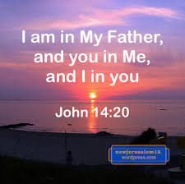
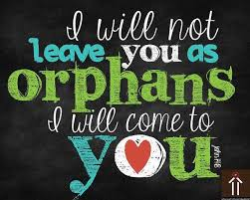
“The world is indeed full of peril, and in it there are many dark places; but still there is much that is fair, and though in all lands love is now mingled with grief, it grows perhaps the greater.” J.R.R. Tolkien

Slide 5

Challenge:
Jesus says, ‘If you love me, you will keep my commands’. Through the ‘Spirit of Truth’, God is always with us, guiding us to make the right choices.
What are Jesus’ commands?
How can you show that you know Jesus’ commands?
Will you put others in your house/class before yourself today?
How will you share God’s love and His forgiveness, His kindness and generosity today?

Slide 6

Let us pray:
Dear God,
Thank you that you never leave us alone.
Send your Holy Spirit to guide and comfort us.
Help us to trust in your love, even when we don’t understand.
Show us how to make good choices each day and to see your goodness in the people around us.
Amen.

