Slide 1
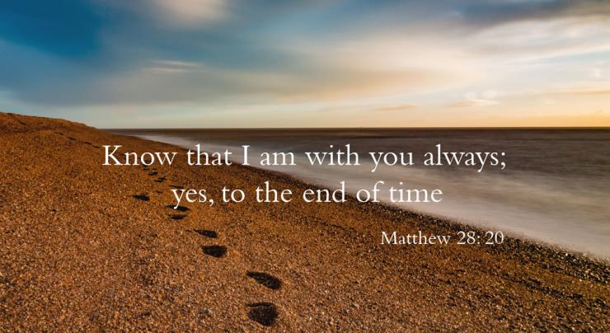
Gospel
The Ascension of the Lord
Matthew 28:16-20
https://www.youtube.com/watch?v=Q5U23GBgYxE

Slide 2
A Reading from the Holy Gospel according to Matthew.
The eleven disciples set out for Galilee, to the mountain where Jesus had arranged to meet them. When they saw him, they fell down before him, though some hesitated. Jesus came up and spoke to them. He said, ‘All authority in heaven and on earth has been given to me. Go, therefore, make disciples of all the nations; baptise them in the name of the Father and of the Son and of the Holy Spirit, and teach them to observe all the commands I gave you. And know that I am with you always; yes, to the end of time.’ (Matthew 28:16-20) The Gospel of the Lord Praise to you Lord Jesus Christ

Slide 3
Reflection
In this Gospel, forty days after his Resurrection, Jesus ascended into Heaven. The disciples were with Him on the mountain as He prepared to leave them. They were devastated that He was going but took comfort from His reassurance that he would be with them always through His Spirit.
Jesus gave instructions to His friends – to make disciples of all the nations, to baptise them in God’s name and to keep His commandments. This was a huge job…to make disciples, to teach and to baptize! However, it was these very acts which made people follow them and want to become Christians. It was by their teaching, the witness of their lives and the power of their actions which made others become followers of Jesus.
From his place with God in heaven, Jesus promised to help his disciples. To this day, He continues to help us, just as He helped them, as we try to live as his followers. If we ask Him, Jesus will help us to keep His commands and follow his example.

Slide 4
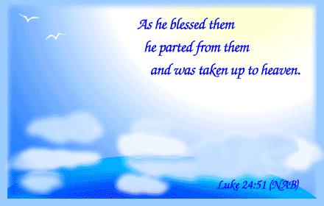
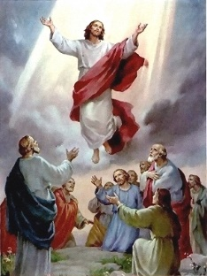
“Jesus’ ascension into heaven does not mean he is absent. Instead, it tells us that he is alive among us in a new way.” Pope Francis

Slide 5
Challenge: Think about a time when you asked another person, who you believed had more knowledge or authority than you, to help you with a difficulty in your life, someone you trust will always be there for you. It may be a parent or a teacher of a friend. These are often the people who can show you, by their actions, that Jesus is always with you. Who do you know who will help you when you have a problem? How can you show others that you will always be there for them? What does it mean to ‘give witness’ by your thought, words and actions?

Slide 6

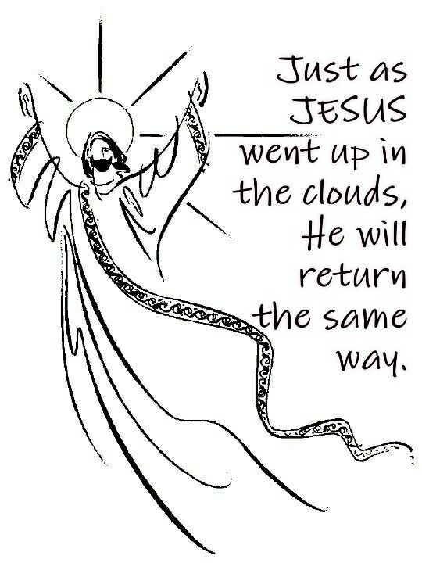

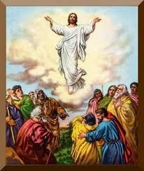
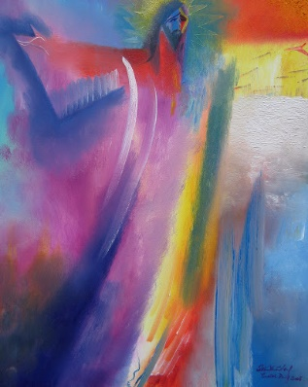

Christ’s Love is our Foundation
Reflect upon the artist impressions of the Ascension of the Lord? What do you like /dislike about each image?

Slide 7
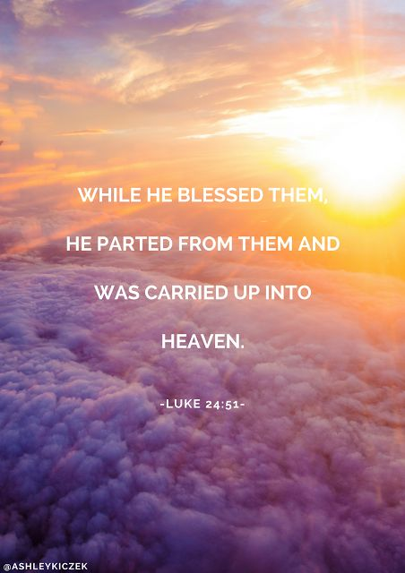

Slide 8
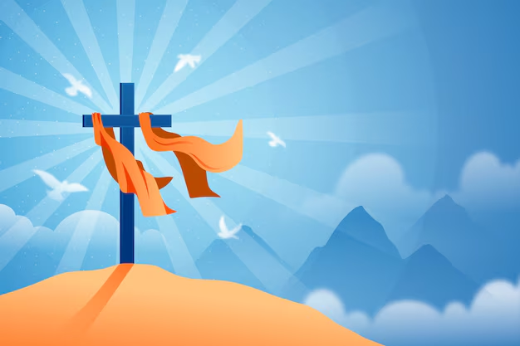
Let us pray: Dear Lord, Before your Ascension into Heaven, you told Your apostles to be witnesses to the ends of the earth with the help of the Holy Spirit. May we be inspired and strengthened by the same Spirit, to live each day the values of our school and so spread your Gospel message in our thoughts, our words and our actions. Amen.

