Slide 1
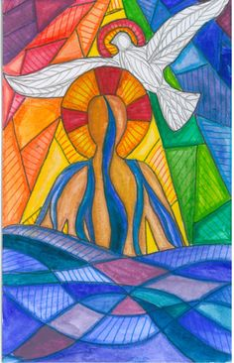
Gospel
The Feast of the Blessed Trinity
John 3:16-18
King of Kings - Hillsong Worship | LYRIC VIDEO

Slide 2
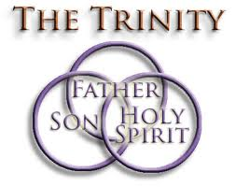
A Reading from the Holy Gospel according to John Jesus said to Nicodemus: ‘God loved the world so much that he gave his only Son, so that everyone who believes in him may not be lost but may have eternal life. For God sent his Son into the world, not to condemn the world, but so that through him the world might be saved. No one who believes in him will be condemned; but whoever refuses to believe is condemned already, because he has refused to believe in the name of God’s only Son. John 3:16-18 The Gospel of the Lord Praise to you Lord Jesus Christ

Slide 3
Reflection:
On this feast day, we celebrate the mystery of the Blessed Trinity, Trinity meaning three.
This is the central mystery of the Christian faith. God the Father, Jesus the Son, and the Holy Spirit. God the Father, out of love for the world, sent his Son into the world as a man, in order to save it. Through the death and resurrection of the Son, Jesus, we have been given the gift of the Holy Spirit.
This is a relationship of unity, of being together but each having different tasks to do - God the Father as our maker and creator of heaven and earth, Jesus, God becoming man and living among us and the Spirit, sent to guide us and give us strength to live the truth in everything we do – three persons, one God.
As three persons, God acts always as a God of love; he does not condemn the world but wants to save it. At the heart of our understanding of the Holy Trinity is the knowledge that God loves us no matter what!

Slide 4
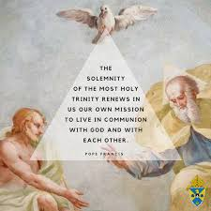

Challenge:
Jesus' promise to the disciples - that the Holy Spirit would be with them and guide them, is still true for all of us today and for all people after us. The Holy Spirit guides us to make the right choices and to use our gifts and talents to the best of our ability to help others.
Last week, we learned that the Holy Spirit brings the gifts of love, joy, peace, patience, kindness, goodness, faithfulness, gentleness and self-control. Your challenge was to bring the fruits of the Spirit to others as witnesses of God’s love.
During this season of Pentecost how have you used these gifts of the Holy Spirit to show God’s love by helping others?
If The Holy Spirit gives us the courage to change things, what can you change in your life which will change the lives of those around you in the best possible way?

Slide 5
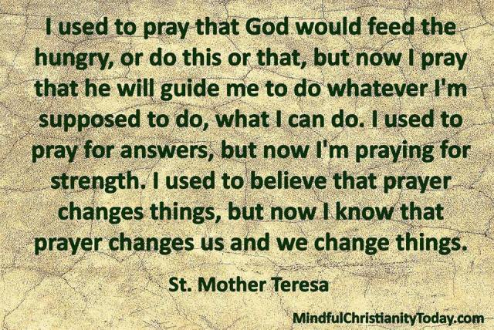

Slide 6
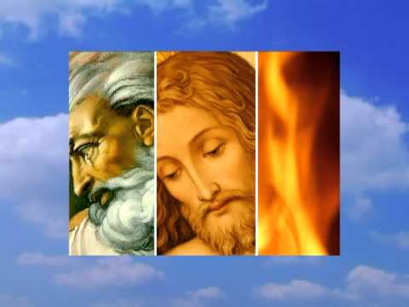
Let us pray: Loving God, you are with us always. Send us your Spirit to strengthen us, to guide us and to give us courage, teaching us to love one another, today and every day, just as Jesus taught us to.
Glory be to God the Father
Glory be to God the Son
Glory be to the Spirit
The holy three in one.
Amen.

