Slide 1
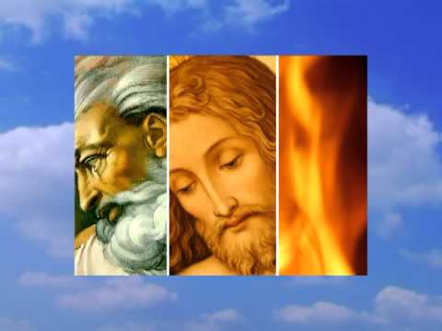
Gospel
The Feast of the Holy Trinity
John 16:12-15
This Little Light of Mine: https://www.youtube.com/watch?v=cKkbIZtqhyQ

Slide 2

A Reading from the Holy Gospel according to John. 3:16 ‘God loved the world so much that he gave his only Son, so that everyone who believes in him may not be lost but may have eternal life. For God sent his Son into the world, not to condemn the world, but so that through him the world might be saved. The Gospel of the Lord Praise to you, Lord Jesus Christ

Slide 3

Reflection
On the Feast of the Holy Trinity, we remember that God is Father, Son, and Holy Spirit, three persons in one God.
In today’s Gospel, we hear how much God the Father loves the world. He sent His Son, Jesus, to save us, and the Holy Spirit helps us to live with love and kindness every day.
The Holy Trinity shows us that God is full of love. Just as the Father, Son, and Holy Spirit are close to one another, God wants us to love and care for each other too.
When we are kind, forgiving, and helpful, we are sharing the love of the Trinity with the world.

Slide 4
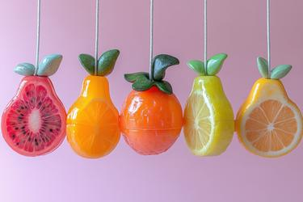
Challenge:
Fruit of Kindness Challenge:
Jesus came to save the world with love. Can you show the fruit of kindness today by helping someone at home or school without being asked?
Fruit of Peace Challenge:
The Holy Trinity teaches us to live in love and peace together. Can you use calm and gentle words if someone upsets you today?
Fruit of Joy Challenge:
God loves you very much! Can you share joy by making someone smile or including someone who feels lonely?
Fruit of Love Challenge:
The Father, Son, and Holy Spirit share perfect love. Can you show love today by saying something kind or praying for someone?

Slide 5
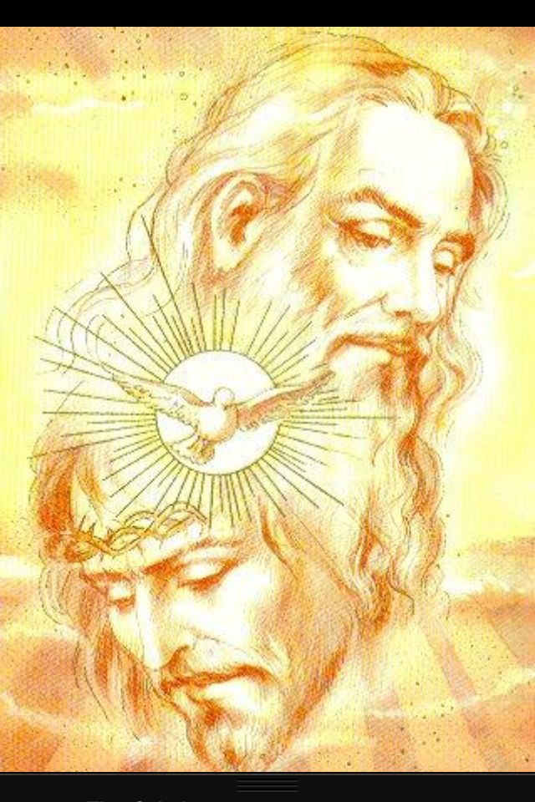
Let us pray: Dear Jesus, you are with us always. Send us your Spirit to teach us how to make the right choices to show our love for God in all that we do. Show us how to be kind to others and to live in peace with each other every day.
Glory be to God the Father
Glory be to God the Son
Glory be to the Spirit
The holy three in one.
Amen.

