Slide 1
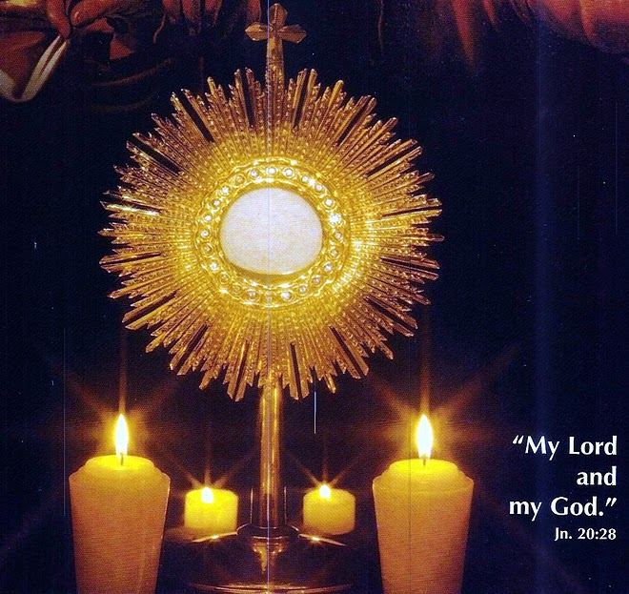
Gospel
The Feast of the Most Holy Body and Blood of Christ
(Corpus Christi) Cycle A
https://www.youtube.com/watch?v=0f1uta1OrFA&list=RD0f1uta1OrFA&start_radio=1

Slide 2
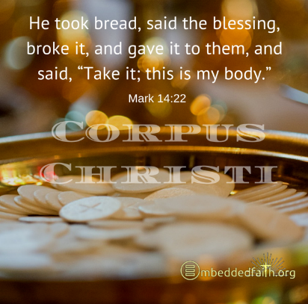
Gospel:
Jesus said to the crowd:
‘I am the living bread which has come down from heaven.
Anyone who eats this bread will live for ever;
and the bread that I shall give is my flesh,
for the life of the world.’
Then the Jews started arguing with one another:
‘How can this man give us his flesh to eat?’ they said.
Jesus replied: ‘I tell you most solemnly,
if you do not eat the flesh of the Son of Man and drink his blood,
you will not have life in you.
Anyone who does eat my flesh and drink my blood
has eternal life,
and I shall raise him up on the last day.
For my flesh is real food
and my blood is real drink.
He who eats my flesh and drinks my blood
lives in me
and I live in him.
As I, who am sent by the living Father,
myself draw life from the Father,
so whoever eats me will draw life from me.
This is the bread come down from heaven;
not like the bread our ancestors ate:
they are dead,
but anyone who eats this bread will live for ever.’ John 6:51-58

Slide 3
Christ’s Love is our Foundation
Reflection:
Jesus tells the crowd that he is the bread of life. He explains that just as God gave the Israelites manna to sustain them in the desert, so now God has sent new manna that will give eternal life. Jesus tells us that He is the living bread, and He will come and live in people through the Eucharist.
In the Gospel story before this one, a crowd of people had gathered. Jesus had blessed five loaves and two fish, and there was enough to feed over five thousand people.
The feeding of the 5,000 is the only one of Jesus' miracles to appear in all four Gospels, apart from the miracle of the resurrection. This makes it a really significant event. The disciples wanted Jesus to send the crowd away. Instead, Jesus empowered them to go out among the crowds and feed the hungry people. The word hunger describes needs that human beings have other than food. We can have spiritual, emotional, and psychological hunger or needs, such as compassion, forgiveness, friendship, affirmation…Jesus wants His disciples to care about the people they meet and make a difference in their lives, no matter what they may hunger for. He wants us, as His disciples, to show God’s love and compassion to everyone we know.

Slide 4
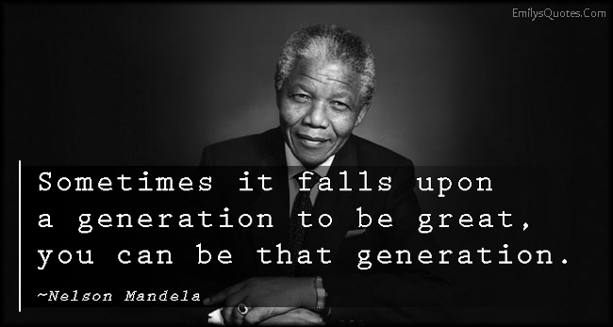
“Overcoming poverty is not a task of charity, it is an act of justice. Like Slavery and Apartheid, poverty is not natural. It is man-made and it can be overcome and eradicated by the actions of human beings. Sometimes it falls on a generation to be great. You can be that great generation. Let your greatness blossom.”
Nelson Mandela

Slide 5
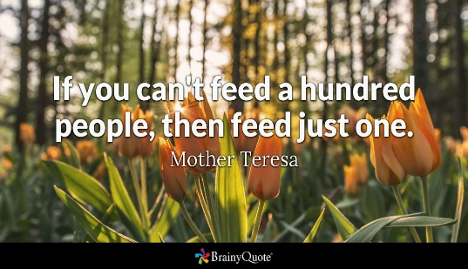
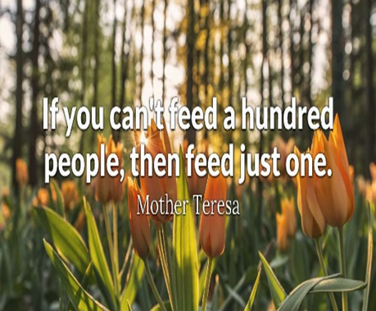
Post-it Challenge:
Let your greatness blossom… start with the small things…
Think of one way which you can feed someone’s needs today…
…Can you be a good listener, share kind words with a friend, donate food to someone who is hungry, stand up for justice, for what is right?
Have I asked God to feed my needs this week?
What are my needs?
Spend two minutes each day reflecting on what it is you need and asking God for His help.
Listen out for God speaking back to you!

Slide 6

Let us Pray:
Catholics believe that Jesus is truly present in the Eucharist
This means that when the priest blesses the bread it becomes the body of Jesus.
He is here to spend time with us. How amazing is that!
Before receiving Jesus in Communion, we say…
Lord, I am not worthy that you should enter under my roof, but only say the word, and my soul shall be healed.

Slide 7
Let us Pray:
Loving Jesus,
You are the Bread of Life who nourishes our hearts and souls.
Help us to recognise the hunger in the people around us, not only for food, but also for friendship, kindness, forgiveness, and hope.
Give us generous hearts to share your love with those in need.
Teach us to be your disciples each day, bringing compassion, encouragement, and joy wherever we go.
May we trust in you and always seek the life and strength that come from you.
Amen.

Slide 8
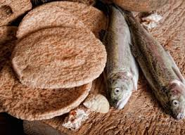
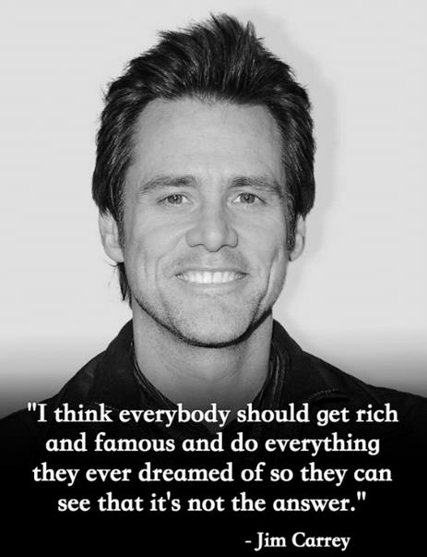
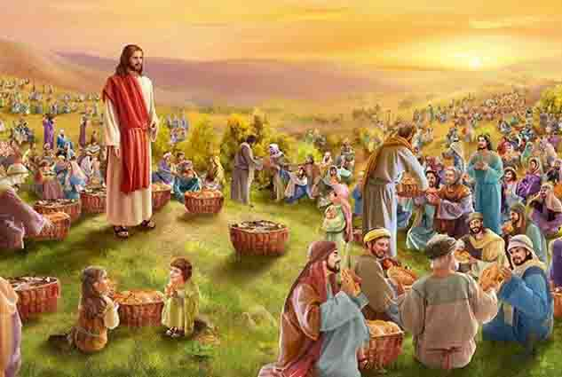
“There’s enough on this planet for everyone’s needs but not for everyone’s greed”– Gandhi

