Slide 1
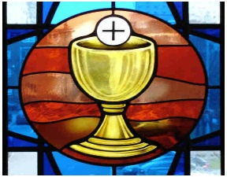
Gospel
The Feast of the Most Holy Body and Blood
of Christ (Corpus Christi) Year A
https://www.youtube.com/watch?v=9h1NzA4OLFI

Slide 2
A Reading from the Holy Gospel according to John …Jesus said to the crowd: ‘I am the living bread which has come down from heaven. Anyone who eats this bread will live for ever; and the bread that I shall give is my flesh, for the life of the world.’ The Gospel of the Lord Praised to you, Lord Jesus Christ

Slide 3
Reflection
Jesus tells the crowd that he is the bread of life. He explains that just as God gave the Israelites manna to feed them in the desert many years before, so now God has sent new manna that will give us eternal life. Jesus tells us that He is the living bread, and He will come and live in people through the Eucharist. (Communion).
In the Gospel story before this one, a crowd of people had gathered. Jesus had blessed five loaves and two fish, and there was enough to feed over five thousand people.
The disciples wanted Jesus to send the crowd away. Instead, Jesus gave them the courage them to go out among the crowds and feed the hungry people.
We usually eat a meal when we are hungry. The word ‘hunger’ describes needs that human beings have other than food. We can have a hunger or need for love, friendship, kindness, gentleness…
Jesus wants His friends to care about the people they meet and make a difference in their lives, no matter what they may hunger for. We are His friends too, so we ask for His help to make us strong and good.

Slide 4
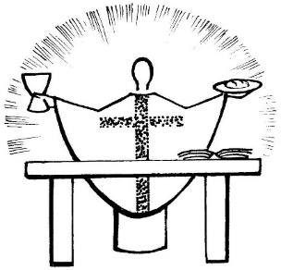
The Eucharist ~
‘…this is my body, this is my blood…’
When the priest blesses the bread and wine it becomes the body and blood of Jesus. We are with Him in the moment of the Last Supper and He is here to spend time with us. How amazing is that!
Before receiving Jesus in Communion, we say the prayer,
Lord, I am not worthy that you should enter under my roof, but only say the word, and my soul shall be healed.

Slide 5
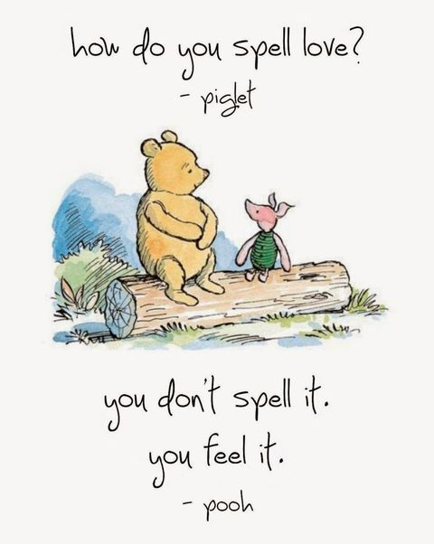
Post-it Challenge:
Let your love grow… start with the small things…
Think of one way which you can share your love with someone today…
Can you be a good listener, share with a friend, speak to someone who is feeling left out, stand up for what is right, can you praise another person today?
Ask yourself, ‘What are my needs? Have I asked God to feed my needs this week?’
Spend two minutes each day reflecting on what it is you need and asking God for His help. Listen out for God speaking back to you!

Slide 6


Let us Pray
Dear Jesus,
You invite us to share at your table, showing your love for us.
May we also be willing to share with others, showing our love for them. Amen

