Slide 1
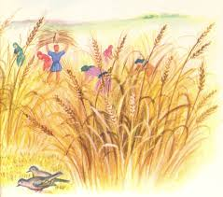
The 11th Sunday of Ordinary time
Matthew 9:36-10:8 Year A
‘The Harvest is rich, but the labourers are few’
https://www.youtube.com/watch?v=52LIC1VtgRc

Slide 2
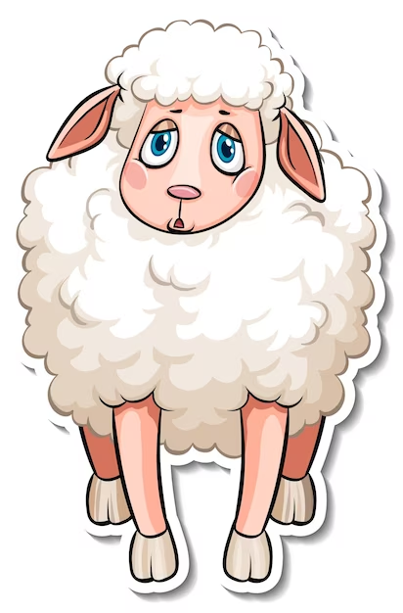
A Reading from the Holy Gospel According to Matthew
When Jesus saw the crowds, he felt sorry for them because they were harassed and dejected, like sheep without a shepherd. Then he said to his disciples, ‘The harvest is rich, but the labourers are few, so ask the Lord of the harvest to send labourers to his harvest.’ …
The Gospel of the Lord
Praise to you Lord Jesus Christ

Slide 3
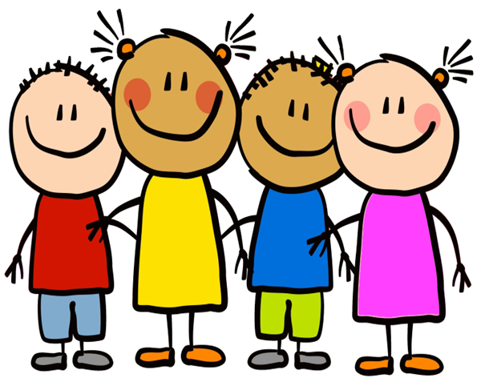
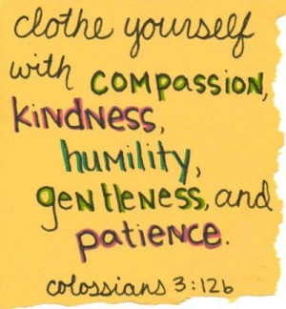
Reflection:
Today’s Gospel tells us that Jesus shares his mission to proclaim the kingdom of heaven with his disciples. He can see that the people are stressed, that they are struggling and that they are looking for help. He is filled with compassion and love for them; however, he doesn’t just feel sorry for them, he also wants to take action to help them. Jesus gathers his twelve disciples, his closest friends, and sends them out with instructions, not only to teach and share his message of love with the people, but also to care for them. Jesus asks them to offer help, support and to heal the people. Jesus asks them to do it all for free, without asking for anything in return. Just as Jesus sent his disciples to continue his work and mission, we are also sent by Jesus to play our part in this mission to bring the kingdom of heaven to earth with our love, our care and our compassion for others.

Slide 4
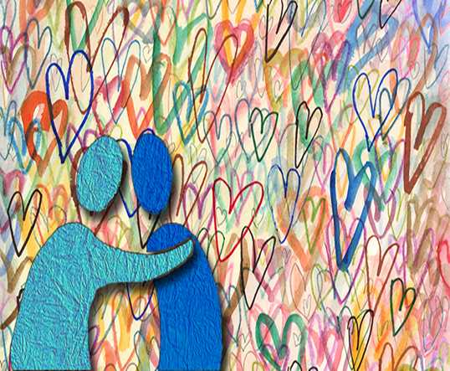
Challenge
Sometimes we are the people who need help.
Sometimes we are the people who can help others.
Can you think of a time when you saw that someone needed your help or was worried about something?
How did you feel?
What did you do?
What will you do this week to share God’s love and to show compassion to those around you? How will you show kindness to others?

Slide 5
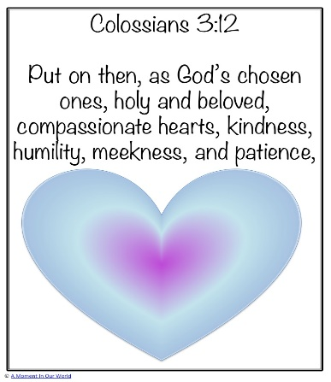
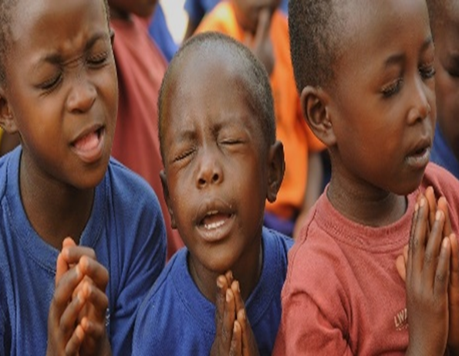
“And whatever you ask in prayer, you will receive, if you have faith.” ~ Matthew 21:22
Lord God, You are full of compassion and love for us, your children. Please give us the strength we need to reach out to those around us, showing kindness in all that we do, Amen.
Blessing
The Lord bless you
and keep you,
The Lord make his face shine on you
and be gracious to you,
The Lord turn his face toward you
and give you peace.
Numbers 6:24-26

