Slide 1
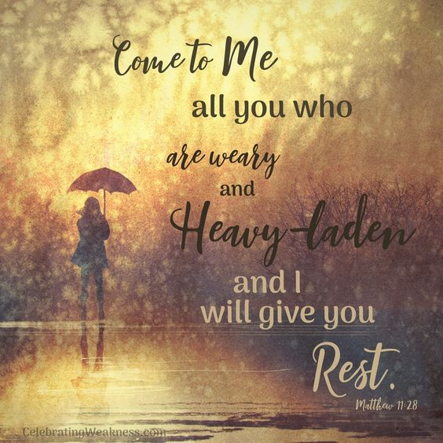
The 14th Sunday of Ordinary time – Year A
Matthew 11:25-30
https://www.youtube.com/watch?v=SI51m2atJ8E

Slide 2
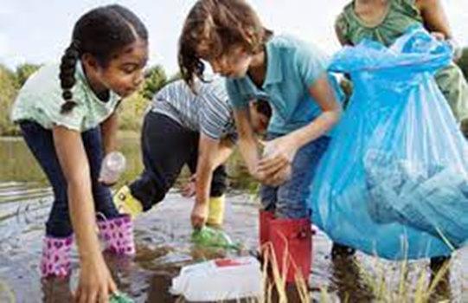
Gospel
The 14th Sunday of Ordinary time – Year A
Jesus exclaimed, ‘I bless you, Father, Lord of heaven and of earth, for hiding these things from the learned and the clever and revealing them to mere children. Yes, Father, for that is what it pleased you to do.
Everything has been entrusted to me by my Father;
and no one knows the Son except the Father,
just as no one knows the Father except the
Son and those to whom the Son chooses to reveal him.
‘Come to me, all you who labour and are overburdened, and I will give you rest. Shoulder my yoke and learn from me, for I am gentle and humble in heart, and you will find rest for your souls.
Yes, my yoke is easy and my burden light.’
Matthew 11:25-30
The Gospel of the Lord
Praise to you, Lord Jesus Christ

Slide 3
Reflection:
In the Gospel today, we learn that Jesus is always there for those who are working hard, for those who are struggling and are feeling tired and weary. At The beginning, Jesus prays to God, His Father in Heaven. He tells us that it is easier for children to learn about God and know God, than it is for clever and learned people.
Jesus is calling out to those who need His help, to those in need, to those suffering from hardship. He knows that we all have times when we find life difficult. He says that He will always be there to care for us and that His yoke is easy. The yoke is wooden bar which farmers in the past would use to make the ploughing easier for the cattle to plough the fields. Jesus is telling us he wants to help us and make things easier for us; when we are tired or finding things difficult, we can turn to Him and find comfort and rest.
Once again, we are reminded of the unity between God the Father and God the Son. God has made himself known through Jesus, and in knowing Jesus, we too come to know the Father.

Slide 4

Post-it Challenge:
‘Jesus is calling out to those who need His help, to those in need, to those suffering from hardship. He knows that we all have times when we find life difficult. He says that He will always be there to care for us…’
We often say that others will see the face of Jesus through our care and kindness towards them.
We are living in difficult times; often people around us are weary, tired and sometimes struggling to cope.
What will you do this week to help someone who needs you to be there for them?
Will you light a candle for someone?
Will you pray for someone?
Will you help around the house?
Will you donate spare food to The Community Larder/Food bank
Will you send a postcard to someone you know?
You can make a difference!

Slide 5
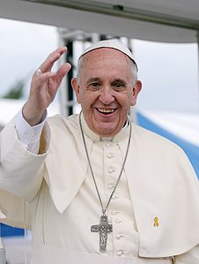
“All it takes is for one good person to restore hope”
Pope Francis
(Be that person!)

Slide 6



Let us pray:
All that I am
I place into your hands
All that I do, Lord
I place into your hands
Everything I work for,
I place into your hands.
Everything I hope for,
I place into your hands.
The troubles that weary me,
I place into your hands.
Thoughts that disturb me,
I place into your hands.
Each person that I pray for,
I place into your hands.
Each person that I care for,
Lord, I place into your hands. Amen

