Slide 1
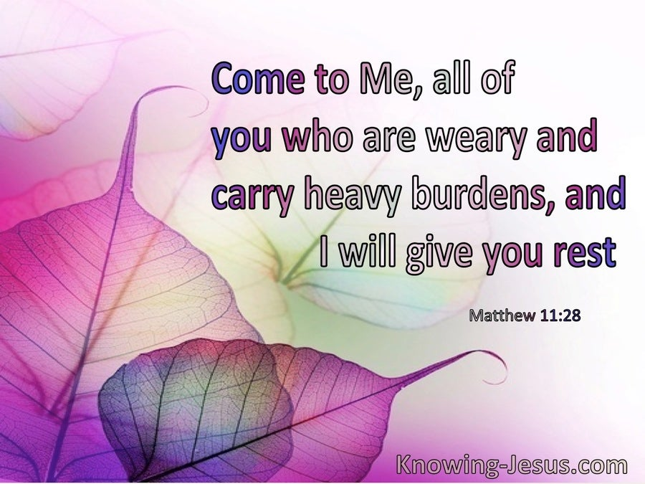
The 14th Sunday of Ordinary time – Year A
Matthew 11:25-30
https://www.youtube.com/watch?v=SI51m2atJ8E

Slide 2
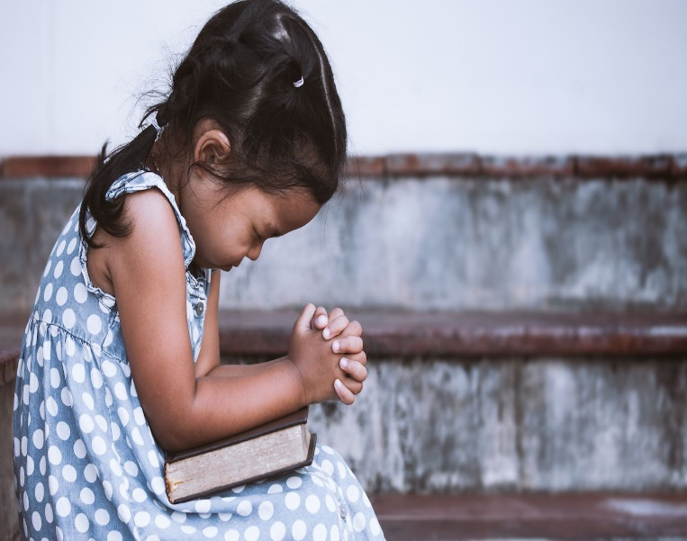
Gospel
The 14th Sunday of Ordinary time – Year A
A Reading from the Holy Gospel According to Matthew
Jesus exclaimed, ‘I thank you, Father, Lord of heaven and of earth, for hiding these things from the learned and the clever and revealing them to mere children. Yes, Father, for that is what it pleased you to do.
The Gospel of the Lord
Praise to you, Lord Jesus Christ

Slide 3

Reflection:
In the Gospel today, we learn that Jesus is always there for those who are working hard, for those who are struggling and are feeling tired and weary.
Jesus prays to God, His Father in Heaven. He tells us that it is easier for children to learn about God and know God, than it is for clever and learned people.
Once again, we are reminded of the unity between God the Father and God the Son. God has made himself known through Jesus, and in knowing Jesus, we too come to know the Father.

Slide 4
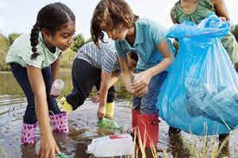
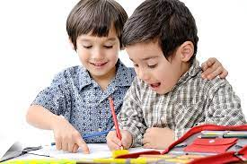

Challenge:
We often say that others will see the face of Jesus through our care and kindness towards them.
We are living in difficult times; often people around us are weary, tired and sometimes struggling to cope.
What will you do this week to help someone who needs you to be there for them?
Will you light a candle for someone?
Will you pray for someone?
Will you help around the house?
Will you donate spare food to The Community Larder/Food bank
Will you send a postcard to someone you know, or speak kind words to them?
You can make a difference!

Slide 5
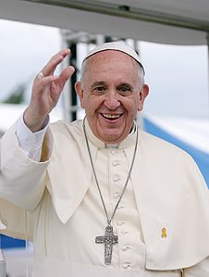
“All it takes is for one good person to restore hope”
Pope Francis
(Be that person!)

Slide 6



Let us pray:
All that I am
I place into your hands
All that I do, Lord
I place into your hands
Each person that I pray for,
I place into your hands.
Each person that I care for,
Lord, I place into your hands. Amen

