Slide 1
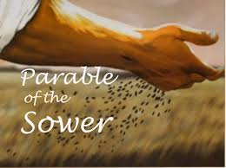
The 15th Sunday of Ordinary time
Matthew 13:1-9
Year A
https://www.youtube.com/watch?v=52LIC1VtgRc

Slide 2
A Reading from the Holy Gospel According to Matthew
Jesus said, ‘Imagine a sower going out to sow. As he sowed, some seeds fell on the edge of the path, and the birds came and ate them up. Others fell on patches of rock where they found little soil and sprang up straight away, because there was no depth of earth; but as soon as the sun came up, they were scorched and, not having any roots, they withered away. Others fell among thorns, and the thorns grew up and choked them. Others fell on rich soil and produced their crop, some a hundredfold, some sixty, some thirty. Listen, anyone who has ears!’ ‘Happy are your eyes because they see, your ears because they hear! I tell you solemnly, many prophets and holy men longed to see what you see and never saw it; to hear what you hear, and never heard it.

Slide 3
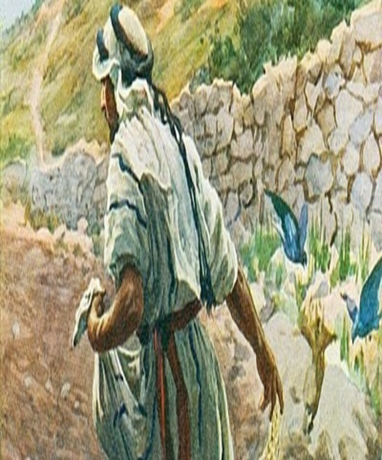
Gospel cont… When anyone hears the word of the kingdom without understanding, the evil one comes and carries off what was sown in his heart: this is the man who received the seed on the edge of the path. The one who received it on patches of rock is the man who hears the word and welcomes it at once with joy. However, he has no root in him, he does not last; let some trial come, or some persecution because of the word, and he falls away at once. The one who received the seed in thorns is the person, who hears the word, but the worries of this world and the lure of riches choke the word and so he produces nothing. And the one who received the seed in rich soil is the man who hears the word and understands it; he is the one who yields a harvest and produces now a hundredfold, now sixty, now thirty.’ The Gospel of the Lord Praise to you Lord Jesus Christ

Slide 4
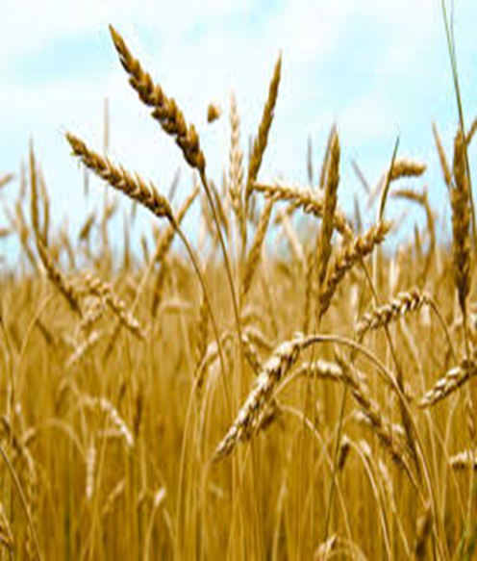
Reflection:
In today’s Gospel, Jesus tells the crowd a parable to show how different people hear the message about the Kingdom of God. The Kingdom of Heaven remains constant, the seeds all come from the same beginning, but the way the message is heard changes depending on circumstances. The seed that falls on the path is like those people who hear what Jesus is saying but do not really understand i or listen to it properly. The seed that falls on the rocks is like the person who hears what Jesus asks us to do and tries really hard to begin with, but who gives up as soon as things become difficult. The seed that falls in the thorns is like someone who hears what Jesus says but is overtaken by wanting the most money and the best of material possessions, rather than being the person Jesus wants us to be. The seed that falls on the rich soil is like someone who hears what Jesus is asking, understands it, and lives their life as he asks them to.

Slide 5
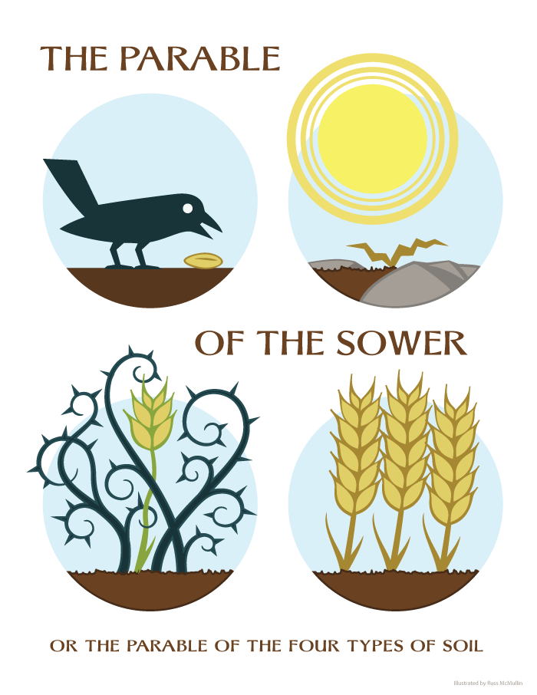

Post-it Challenge:
So, at this point in your life, what type of seed best describes you?
When I hear the word of God, do I try to understand, give praise and grow in my faith? How can I become the good soil needed for God’s word to take root and for my seed to grow? Do I need to change? If so, how might I begin to make a change?
This week, see if you can be the seed that falls on the rich soil – listen to what Jesus asks of you, try to understand it and live your life as God calls you to do.

Slide 6

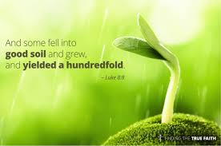
Let us pray: Lord Jesus, Bless with courage and spirit your people here on earth, helping us to find ways to be the rich soil, responding in service to others before ourselves. Give us the grace to pause and reflect on our every action so that the seeds you have sown in our hearts grows one hundred-fold. Help us to respond to your call in all that we say and do in our lives. Amen.

