Slide 1
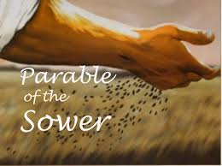
The 15th Sunday of Ordinary time
Matthew 13:1-9
Year A
https://www.youtube.com/watch?v=52LIC1VtgRc

Slide 2
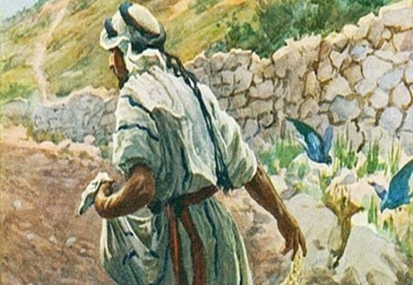
A Reading from the Holy Gospel According to Matthew
Jesus said, ‘Imagine a sower going out to sow. As he sowed, some seeds fell on the edge of the path, and the birds came and ate them up. Others fell on patches of rock where they found little soil and sprang up straight away, because there was no depth of earth; but as soon as the sun came up, they were scorched and, not having any roots, they withered away. Others fell among thorns, and the thorns grew up and choked them. Others fell on rich soil and produced their crop, some a hundredfold, some sixty, some thirty. Listen, anyone who has ears!’
The Gospel of the Lord
Praise to you Lord Jesus Christ

Slide 3
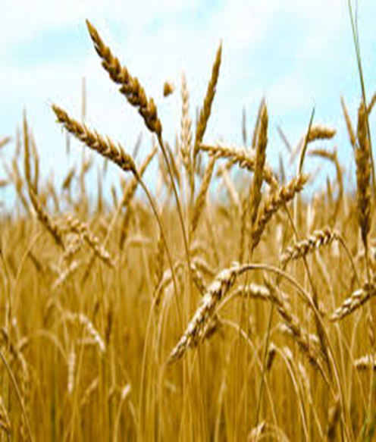
Reflection:
In today’s Gospel, Jesus tells the crowd a parable to show how different people hear the message about the Kingdom of God. The Kingdom of Heaven remains constant, the seeds all come from the same beginning, but the way the message is heard changes depending on circumstances. The seed that falls on the path is like those people who hear what Jesus is saying but do not really understand i or listen to it properly. The seed that falls on the rocks is like the person who hears what Jesus asks us to do and tries really hard to begin with, but who gives up as soon as things become difficult. The seed that falls in the thorns is like someone who hears what Jesus says but is overtaken by wanting the most money and the best of material possessions, rather than being the person Jesus wants us to be. The seed that falls on the rich soil is like someone who hears what Jesus is asking, understands it, and lives their life as he asks them to.

Slide 4
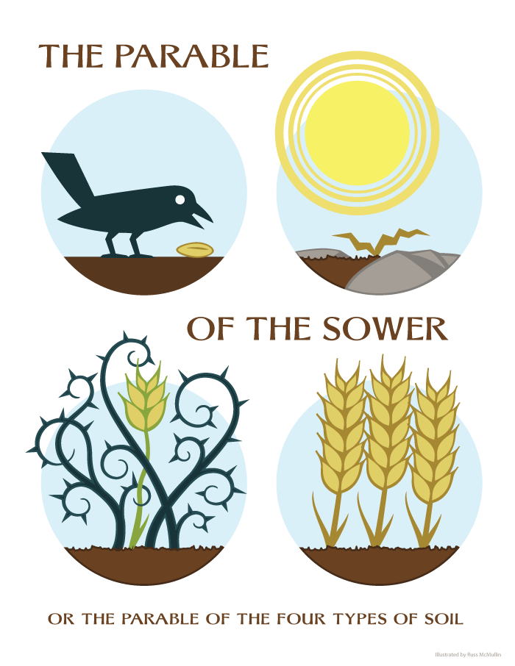

Challenge:
Jesus tells us that our hearts are like different kinds of soil. When we are kind, listen carefully, and choose to do what is right, we are like good soil where love can grow. Every day we have a chance to help God's love grow in us.
So, at this point in your life, what type of seed best describes you?
This week, see if you can be the seed that falls on the good soil – listen to what Jesus asks of you, try to understand it and live your life as God calls you to do.
How can I do this?
you can help someone,
share with a friend
listen carefully to your teacher,
include someone who is feeling lonely.

Slide 5

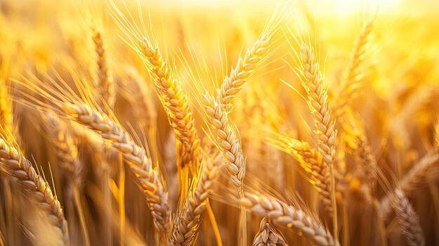
Let us pray: Lord Jesus, Thank you for loving us. Help our hearts to be like good soil where kindness, love, and joy can grow. Help us to listen to your words and to show your love to everyone we meet this week. Amen.

