Slide 1
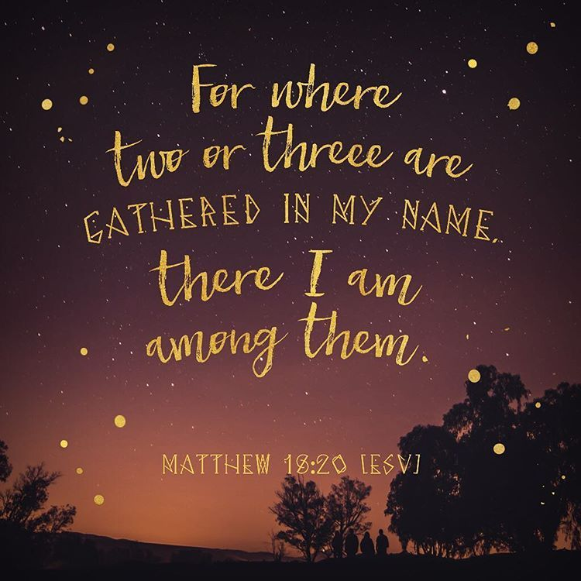
The 23rd Sunday of Ordinary time
Matthew 18:15-20
Year A
https://www.youtube.com/watch?v=52LIC1VtgRc

Slide 2
A Reading from the Gospel According to
Matthew18:15-20
Jesus said to his disciples: ‘If your brother does something wrong, go and have it out with him alone, between your two selves. If he listens to you, you have won back your brother. If he does not listen, take one or two others along with you: the evidence of two or three witnesses is required to sustain any charge. But if he refuses to listen to these, report it to the community; and if he refuses to listen to the community, treat him like a pagan or a tax collector.
‘I tell you solemnly, whatever you bind on earth shall be considered bound in heaven; whatever you loose on earth shall be considered loosed in heaven.
‘I tell you solemnly once again, if two of you on earth agree to ask anything at all, it will be granted to you by my Father in heaven. For where two or three are gathered in my name, I shall be there with them.
The Gospel of the Lord.
Praise to you Lord Jesus Christ

Slide 3
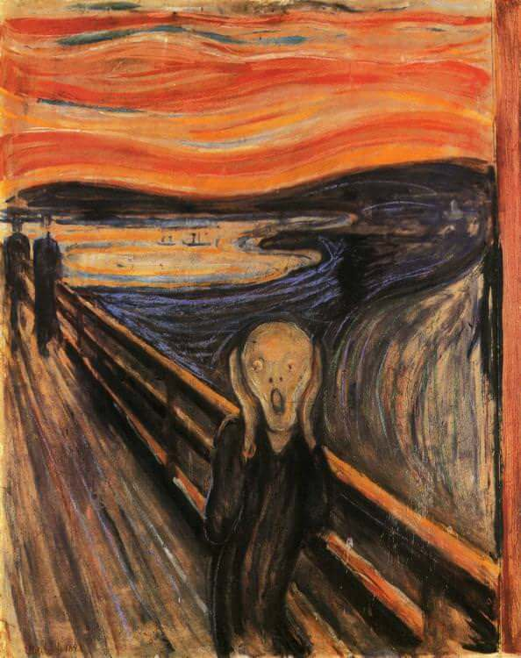
Reflection
The Gospel message this week is very much about listening and healing relationships. Amid crises that have recently shaken our world, we have been awakened to the urgent need to heal our relationships, not just with each other, but with creation.
The next five weeks are known in the Church as the ‘Season of Creation’, marking the fifth anniversary of ‘Laudato Si’, a letter written by Pope Francis. This letter is addressed to every person on the planet, asking us all to listen to the cry of the earth.
A famous painting, ‘The Scream’ by the artist, Edvard Munch has recently been in the news. A note from the artist was found on the back of one of his lithographs, explaining that this painting was of someone blocking out the sounds of the screams of nature!
Cont…

Slide 4
Reflection continued …
God speaks to us through nature. When we see a beautiful sunrise or sunset, or notice the beauty of the changing seasons, or new life, this is when God is speaking to us through his creation, and we are asked to listen to His voice. God’s creation is under huge pressure from humanity – from the carbon fuels, melting icecaps, destruction of trees, plastics, pollution…the list is immense! Pope Francis reminds us that nature is speaking to us and we need to listen now! We must show respect for the beauty of our world and teach others to do so. We can campaign for change - we can pray for change – we can be the change!

Slide 5


Challenge
Think of five things in nature for which you are grateful.
If we can hear the voice of nature, what is it saying to us?
Watch the animation of ‘Laudate Si’: https://www.youtube.com/watch?v=o3Lz7dmn1eM
Think of one thing you might change which will make a difference in the world. How will you action this change?
For a few moments in silence, think about why you might find this difficult and ask for God's help.
Now, be still and in the silence, pray for the earth and for each other.

Slide 6
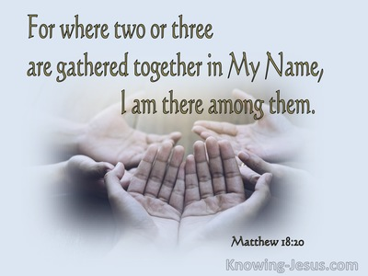
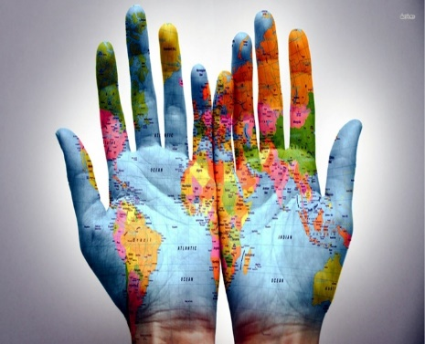
Let us pray:
Creator God,
Thank you for our beautiful world and for appointing us as its guardians.
Inspire us to care for the environment,
Help us to rebuild lives and communities; to share in the griefs and anxieties, joys and hopes of all your people.
Let us listen to the cries of nature so that your creation may flourish. Amen.
(Adapted from CAFOD prayer for our world.)

