Slide 1
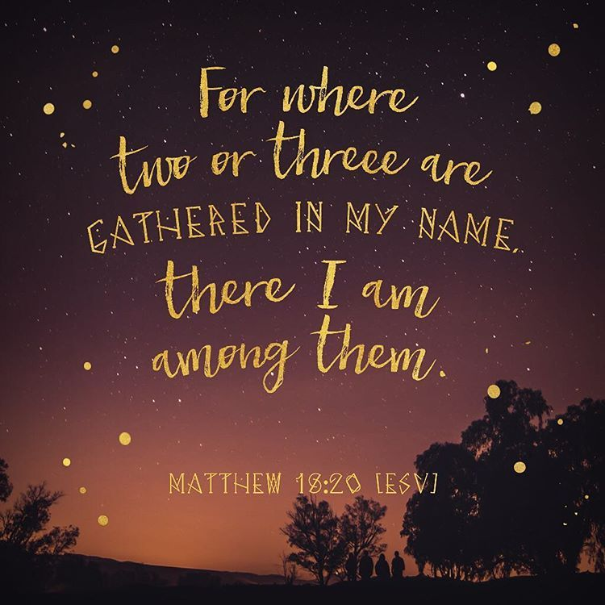
The 23rd Sunday of Ordinary time
Matthew 18:15-20
Year A
https://www.youtube.com/watch?v=52LIC1VtgRc

Slide 2
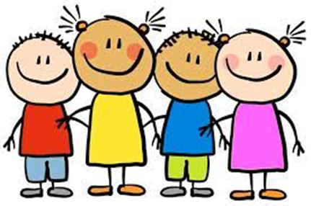
A Reading from the Gospel According to Matthew
I tell you solemnly once again, if two of you on earth agree to ask anything at all, it will be granted to you by my Father in heaven.
For where two or three are gathered in my name, I shall be there with them.’
The Gospel of the Lord.
Praise to you Lord Jesus Christ

Slide 3
Reflection
God speaks to us through nature. When we see a beautiful sunrise or sunset, or notice the beauty of the changing seasons, or new life, this is when God is speaking to us through his creation, and we are asked to listen to His voice.
Pope Francis reminds us that nature is speaking to us and we need to listen now!
We must show respect for the beauty of our world and teach others to do so.
Jesus says, “Where two or three are gathered in my name, I am there with them.”
When Jesus is with us, we can campaign for change - we can pray for change – we can be the change!

Slide 4
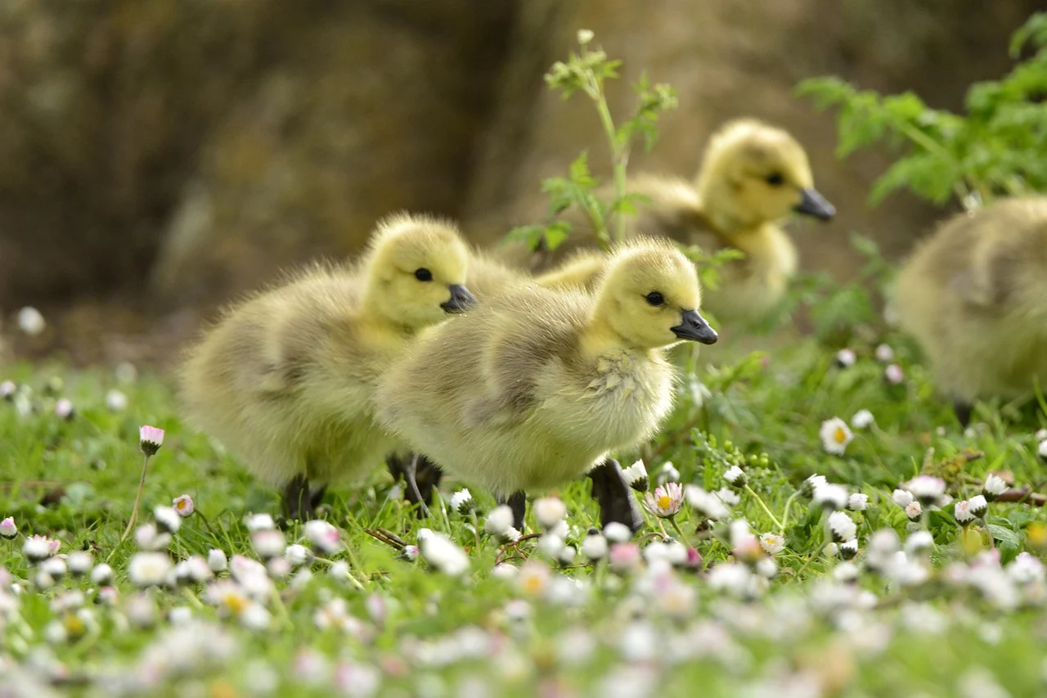
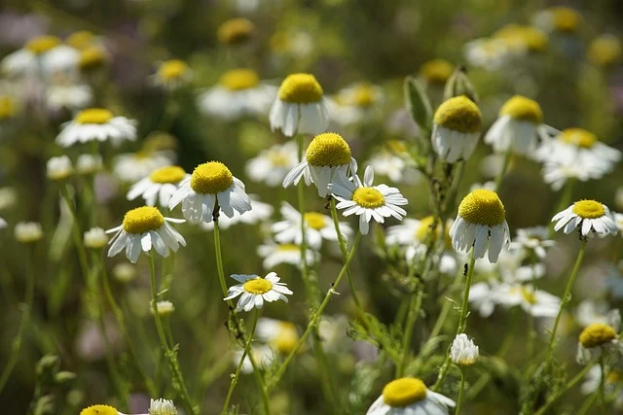
Post-it Challenge:
Think of five things in nature for which you are grateful.
If we can hear the voice of nature, what is it saying to us?
Watch the animation of ‘Laudate Si’: https://www.youtube.com/watch?v=o3Lz7dmn1eM
Think of one thing you might change which will make a difference in the world. How will you action this change?
For a few moments in silence, think about why you might find this difficult and ask for God's help.
Now, be still and in the silence, pray for the earth and for each other.

Slide 5
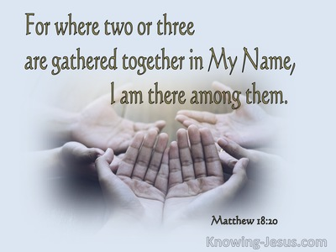
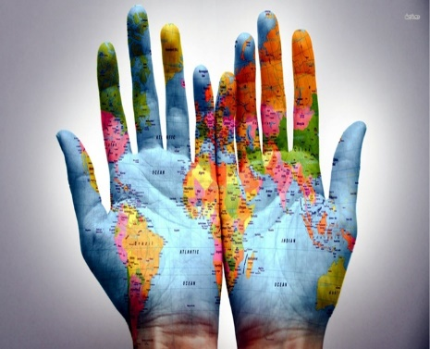
Let us pray
Creator God,
Thank you for our beautiful world and for all the wonderful things you have made.
Help us to look after our planet and care for all living things.
Help us to care for people who are sad or worried, and to share in their happiness and hopes.
Help us to listen to the needs of our world so that your beautiful creation can grow and flourish. Amen.

