Slide 1
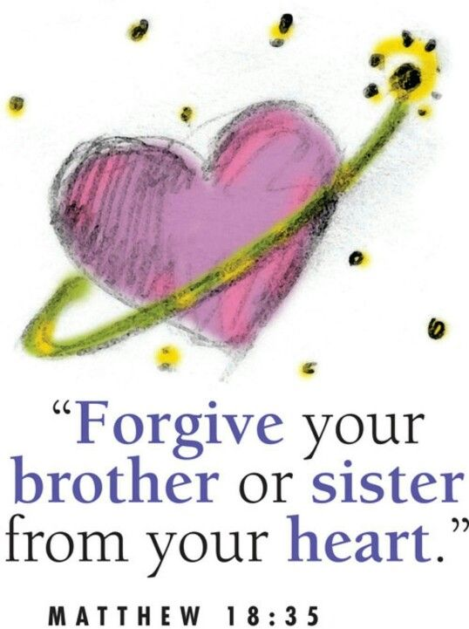
The 24th Sunday of Ordinary time, Year A
Matthew 18:21-35
https://www.youtube.com/watch?v=bj1H-CEtntE

Slide 2
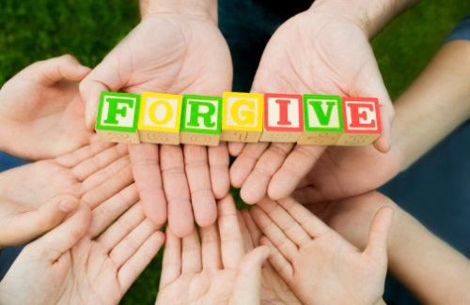
A Reading from the Holy Gospel According to Matthew
Peter went up to Jesus and said, ‘Lord, how often must I forgive my brother if he wrongs me? As often as seven times?’ Jesus answered, ‘Not seven, I tell you, but seventy times seven times.’

Slide 3
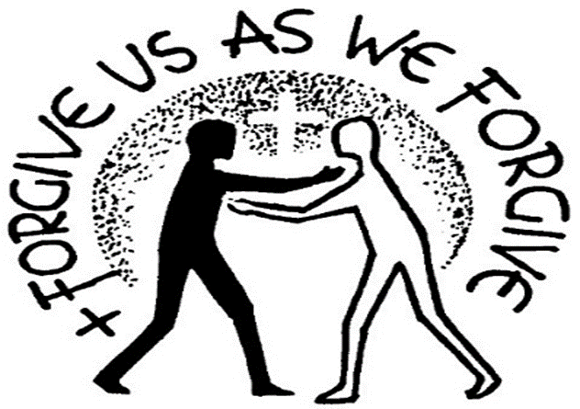
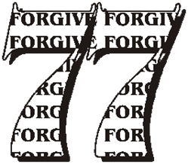
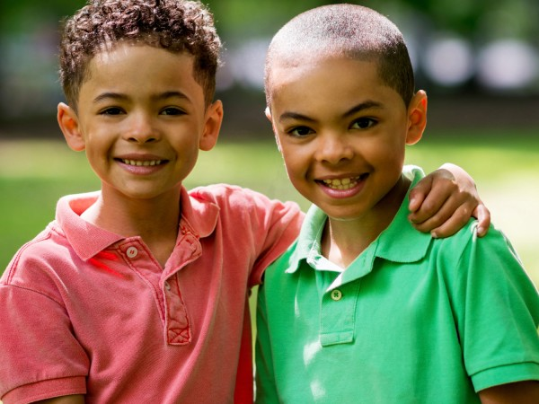
Reflection:
In our Gospel this week Jesus talks about forgiveness – about how God is always ready to forgive us if we say sorry. And about how we should try to forgive others if they say sorry to us.
Jesus is telling us that forgiveness is not just about quantity—the number of times we forgive one another. It’s about the depth of our forgiveness and how we behave in future.
We should forgive one another from the heart. God's forgiveness transforms us, helping us to be as forgiving and merciful as God is towards us.
Jesus is saying, don’t keep a record, just keep on forgiving. In this way we demonstrate God’s love and forgiveness to the world.

Slide 4

Post-it Challenge:
Can you think of a time when you have been forgiven? How did you feel?
Can you think of a time when someone has said sorry and tried to change and you did forgive them?
How did you feel then?
Now reflect on the promises of Psalm 103.
‘As high as the sky is above the earth,
So great is his love for those who honour him.
As far as the east is from the west,
So far does he remove our sins from us.’
What do these words tell us about God?

Slide 5



Let us pray:
Dear Jesus,
Help me to share your forgiveness with others. You know all my sins and wrong choices.
Forgive me, accept me and strengthen me.
Guide me to do what is right so that I can make this world a better place for my friends and family.
Amen

