Slide 1





Slide 2

Agenda
Residential
Secondary school application
Pupil funding (Expanded- FSM Targetted- FSM, Trips & uniform)
Wonderlab (girls only)
Homework

Slide 3

JCA are a leading provider of school activity courses in the UK, with over 30 years’ experience
providing quality residential trips.
Operating from 4 centres across the country, they deliver high quality educational experiences that meet the needs of every child.
Their courses encompass a range of outdoor activities to encourage personal development, inspire and motivate learning, foster independence and build confidence, all in a safe environment.

Slide 4

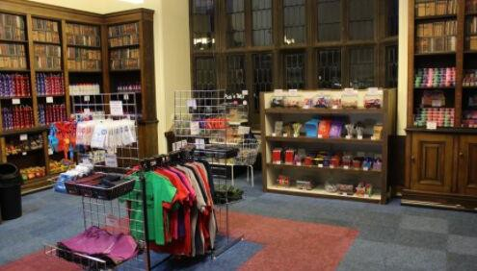
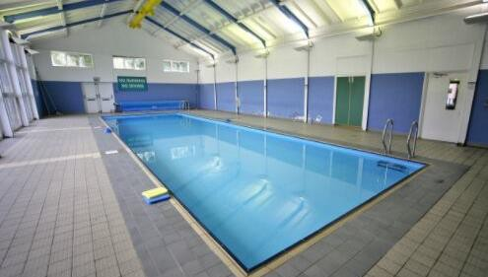
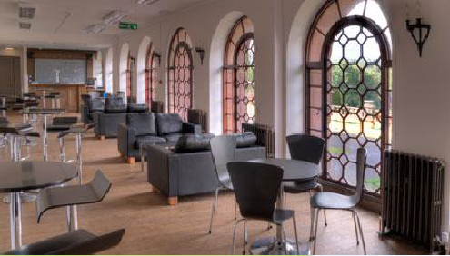
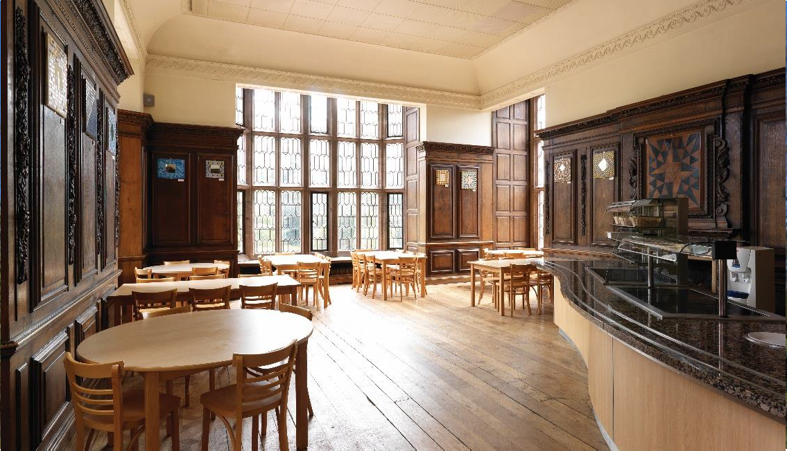
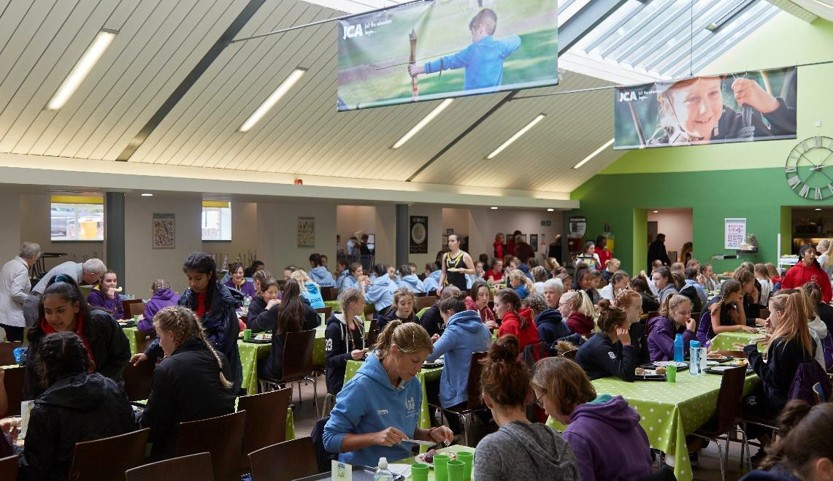

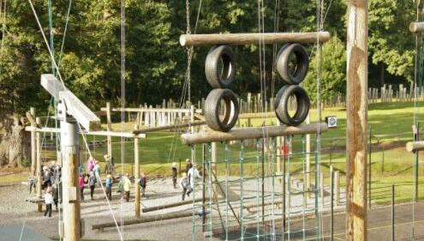
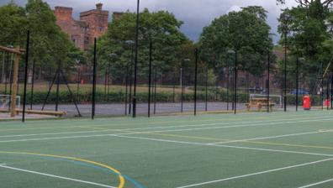
Tuck shop/Gift shop
Indoor swimming pool
'The Orangery', adult bar
Cafe
Restaurant
All weather sports pitches

Slide 5

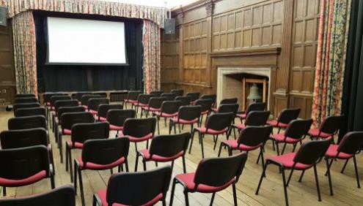
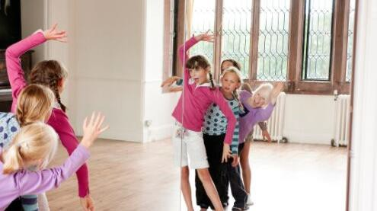
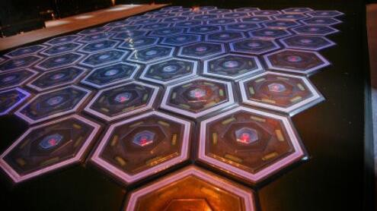
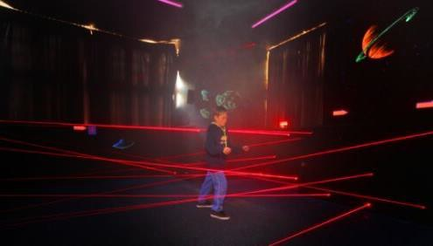
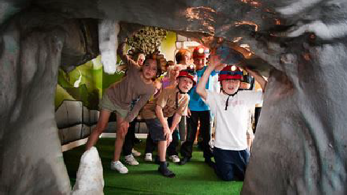
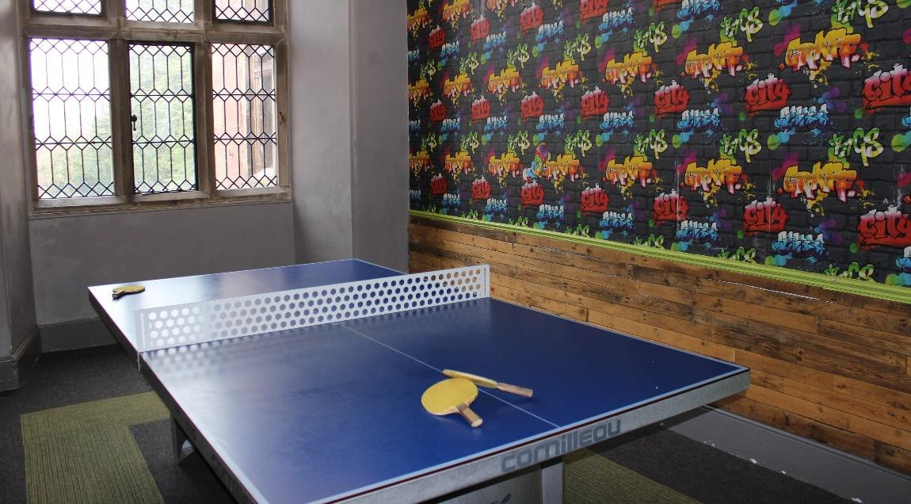

Cinema Room
Dance studio
Grid of stones
Laser maze
Tunnelling room
Games room

Slide 6

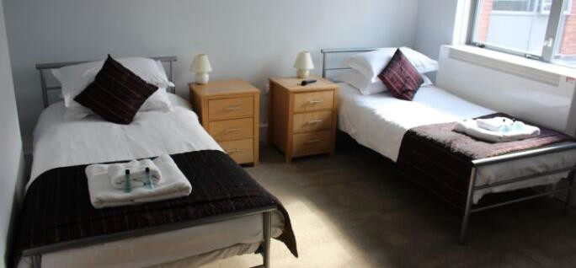
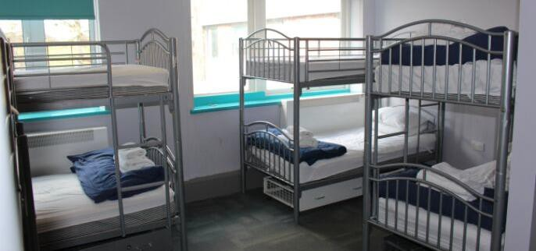
There are options of multi-bedded dorms (4 – 12 beds) for students, with most offering en-suite facilities.
Rooms are a mixture of twins and singles, mostly with en-suite facilities within the same building as the children.
Senior staff members are on duty until 10:30pm each day with night staff patrolling between the hours of 10:30pm and 07:30am.
Centre doors are secured in the evening, but can be opened in case of emergency and security barriers guard the entrance to the site.
Party Leader room
Student room

Slide 7

DAY ACTIVITIES
EVENING ACTIVITIES
Abseiling
Aerial Trek
Archery
Buggy Building
Canoeing
Climbing
Dance Mania
Fencing
Grid of Stones
High Ropes
Initiative Exercises
Laser Conquest
Low Ropes
Orienteering
Raft Building
Sensory Trail
Sit-on-top Kayaking
Tunnelling
Wet and Wacky
Zip Wire
Busted
Campfire
Film Night
Disco (Loud and Silent)
Giant Cluedo
Laser Conquest
League Toppers
Nocturnal Safari
Run Around Quiz
A complete list of activities to choose from at Condover Hall can be found on our website

Slide 8

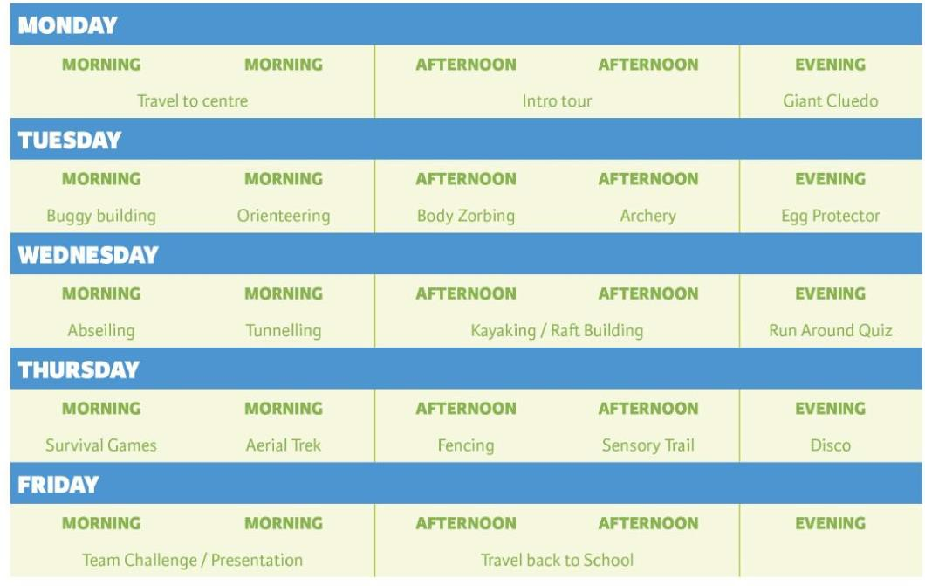
This is a sample itinerary to show how activities are scheduled.
Your week will be structured to meet your requirements and choice of activities.

Slide 9


Slide 10
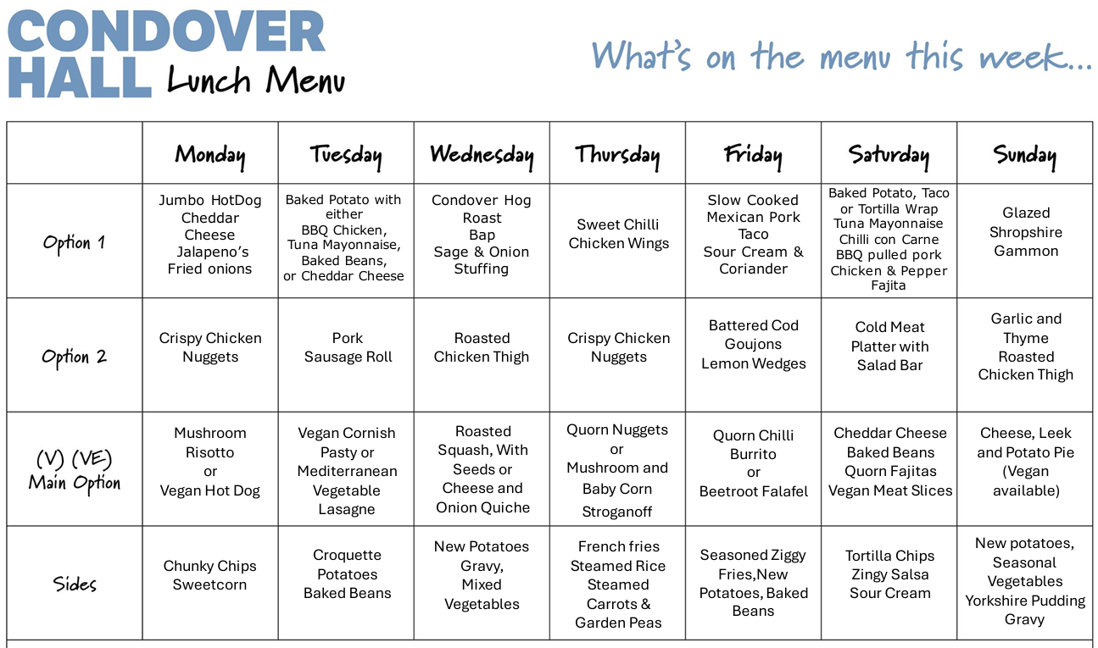

Slide 11
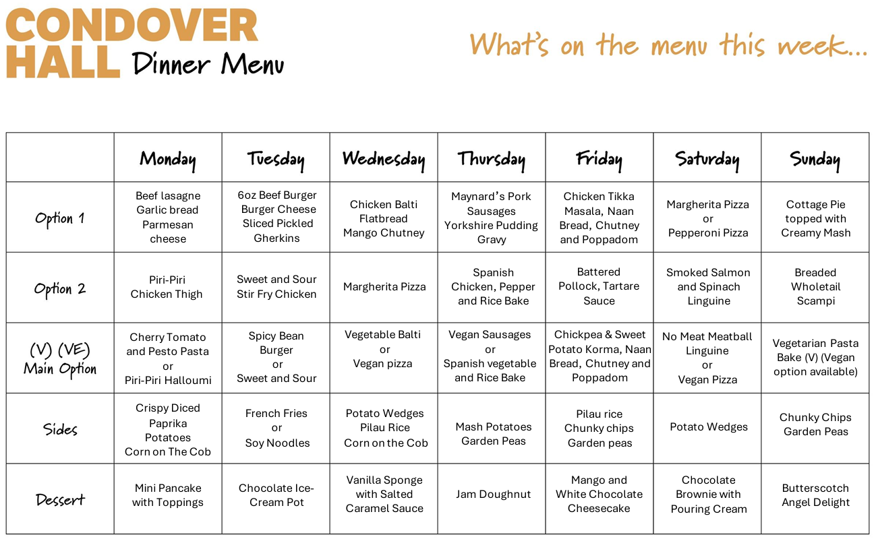

Slide 12
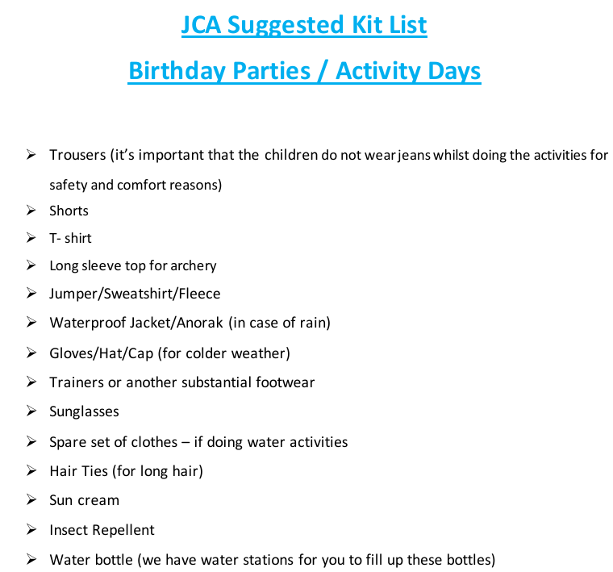

Slide 13
Cost
The total cost of the visit to Condover Hall is £225 and includes: Full board accommodation, transport from the school to the centre and return, all instruction and activities, equipment & safety equipment, evening activities programme, achievement certificates and comprehensive insurance.
Payment can be made in full or in monthly instalments. Full payment must be made by 5th April 2027.
Residential date 12th July to 14th July, 2027.

Slide 14
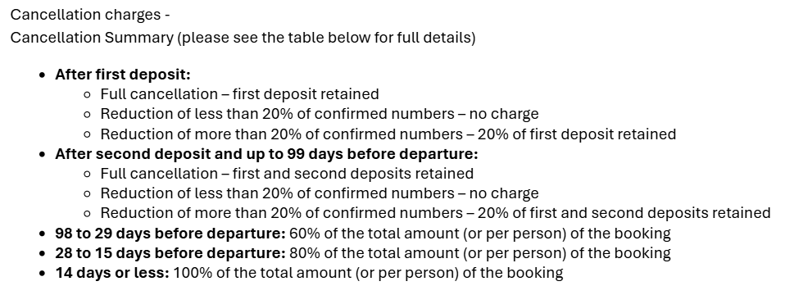

Slide 15
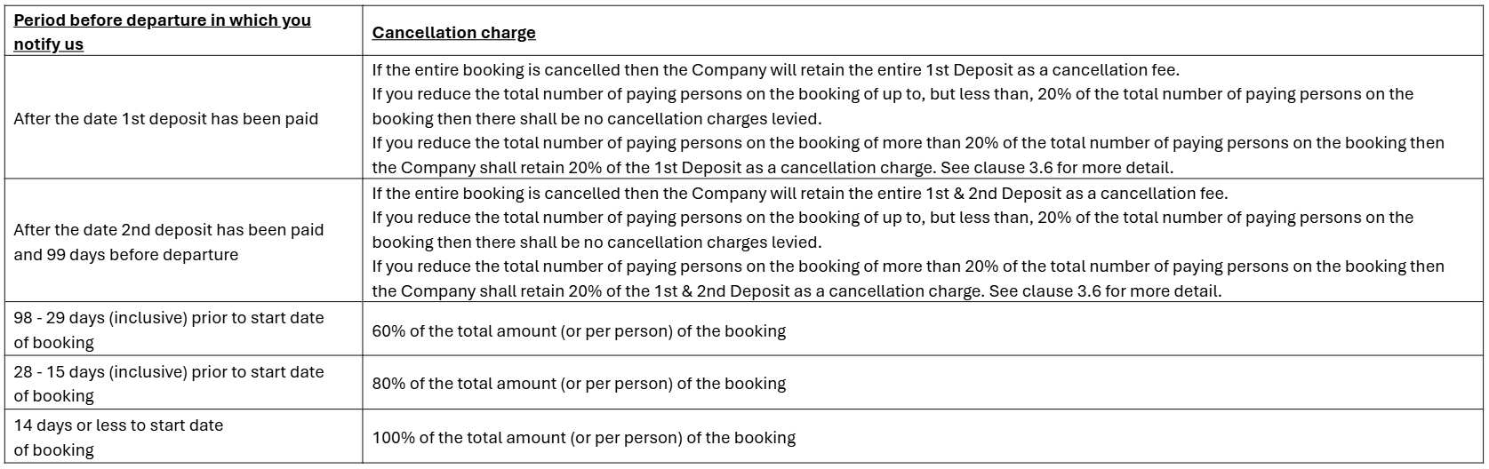

Slide 16






JCA are governed by, affiliated to and accredited with:
British Activity Providers Association (BAPA)
Institute for Outdoor Learning (IOL)
Association of British Travel Agents (ABTA)
Learning Outside the Classroom (LOtC)
Adventuremark (AAIAC)

