Slide 1
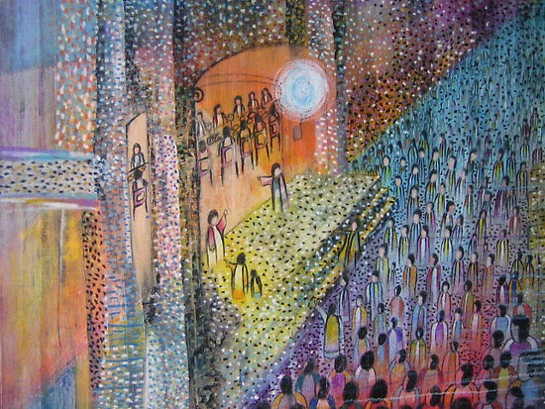
The 28th Sunday of Ordinary time
Matthew 22:1-12
Year A
In The Name Of Jesus | JWLKRS Worship & Maverick City feat. Chandler Moore (Official Music Video)

Slide 2
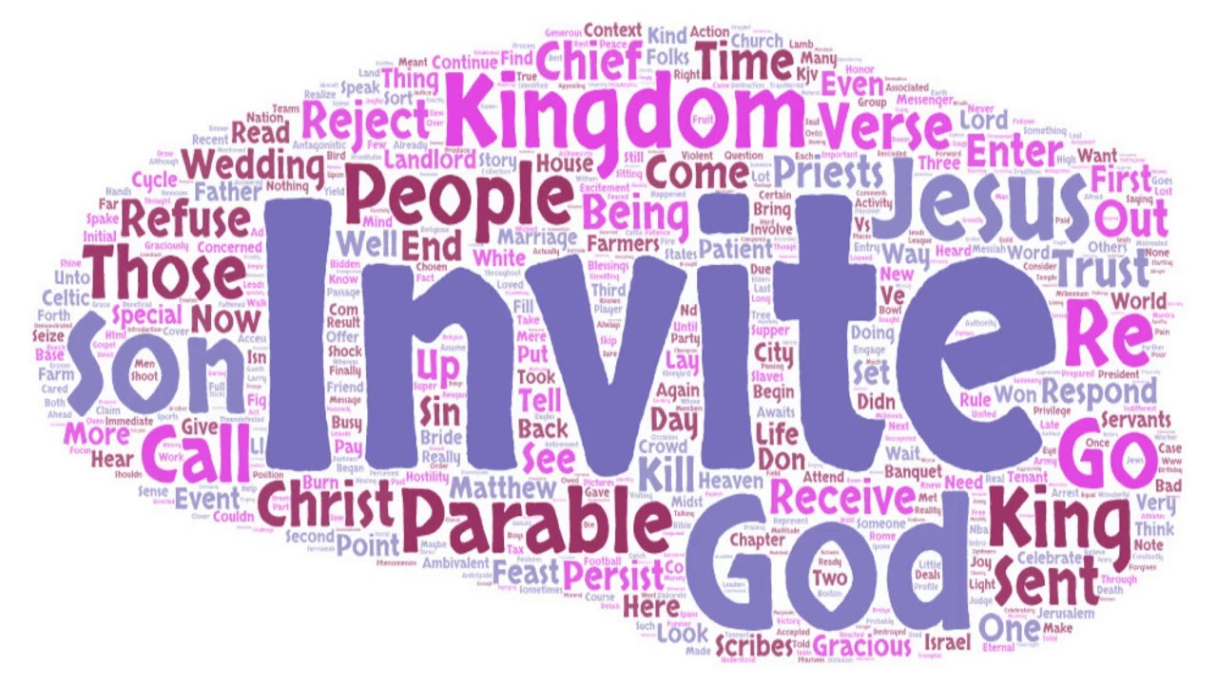
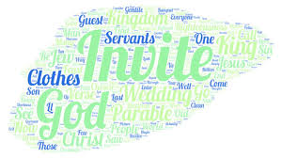
A Reading from the Holy Gospel According to Matthew (22:1-12)
Jesus said, “The kingdom of heaven is like a king who prepared a wedding feast for his son. The king invited some people to the feast. When the feast was ready, the king sent his servants to tell the people to come. But they refused to come to the feast.
“Then the king sent other servants. He said to them, ‘Tell those who have been invited that my feast is ready. I have killed my best bulls and calves for the dinner. Everything is ready. Come to the wedding feast.’
“But the people refused to listen to the servants. They went to do other things. One went to work in his field, and another went to his business. Some of the other people grabbed the servants, beat them, and killed them. The king was very angry. He sent his army to kill the people who had killed his servants. And the army burned their city.
“After that, the king said to his servants, ‘The wedding feast is ready. I invited those people, but they were not worthy to come. So, go to the street corners and invite everyone you see. Tell them to come to my feast.’ So, the servants went into the streets. They gathered all the people they could find, both good and bad. And the wedding hall was filled with guests.

Slide 3

Reflection:
In another parable from Jesus, the king’s son is getting married. He invites all those closest to him to the party, but when the day comes and the king sends out his servants to fetch the people they do not come. He tries again, but the people just make excuses not to come.
The king then sends out his servants to stand in the middle of the street and invite everyone they can find to the wedding. At this point, the wedding hall is filled with guests. Like the King, God is generous and loves us so much that he invites everyone to come to his table and share in his gifts. All are welcome.
We are all invited by God to enter into the Kingdom of Heaven. It is a place where everyone can belong. But we have to be ready, by living how Jesus asks us to and not make excuses why we cannot do this.

Slide 4
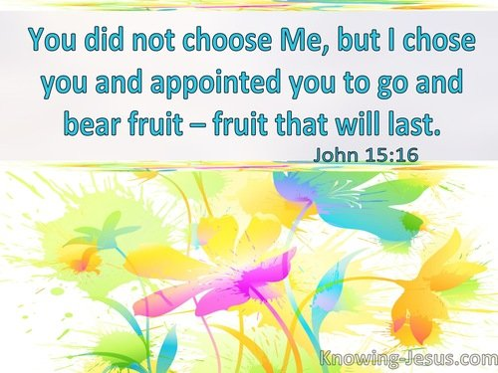
Reflection cont ….
Jesus also teaches us in this Gospel the importance of humility as we hope one day for God’s kingdom. Many people in Jesus’ day, including those who considered themselves religious, were actually spiritually blind and deaf. They failed to see God at work in Jesus. Do we just pretend to be holy on the outside or do our actions allow others to see God working through us?
We are all chosen by God…we now must choose how we respond to the invitation.

Slide 5



Post-it Challenge:
By answering God’s invitation to be kind, generous, forgiving and non-judgemental of others, we can help to reflect God’s kingdom here on earth. We will help other people to see that we care for everyone, no matter who they are or where they come from and the world will be a better place.
What is your response to Jesus’ invitation?
Are you willing to accept or are you too busy?
We can listen to God’s word and try to follow what God asks us to do in our lives.
What do you think God asks us to do?
How can you answer God’s invitation?
This week try to listen to what God wants from you and say ‘yes’ to His invitation by the way you behave.

Slide 6

Let us pray:
Disturb us, Lord, when
We are too well pleased with ourselves,
When our dreams have come true
Because we have dreamed too little,
When we arrived safely
Because we sailed too close to the shore.
Disturb us, Lord, when
With the abundance of things we possess,
we have lost our thirst for the waters of life.
Disturb us, Lord, to dare more boldly, to venture on wider seas
Where storms will show your mastery;
Where losing sight of land, we shall find the stars.
We ask You to push back the horizons of our hopes;
And to push into the future in strength, courage, hope, and love. Amen.
Attributed to Sir Francis Drake, c. 1577

