Slide 1
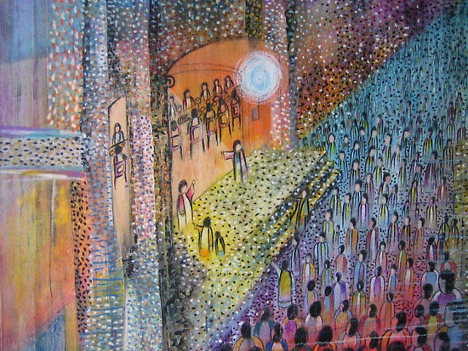
The 28th Sunday of Ordinary time
Matthew 22:1-12, Year A
Autumn Days When the Grass is Jewelled (singing and lyrics) (StF 121 / BBC Come and Praise 4)

Slide 2

A Reading from the Holy Gospel according to Matthew
(Adapted from Matthew 22:1-10
The king said to his servants,
“The feast is ready! Go out and invite everyone you meet to come and join us.”
The servants went out into the streets and invited everyone they saw.
Lots of people came, and soon the room was full of guests.
Everyone was welcome at the king’s feast.

Slide 3
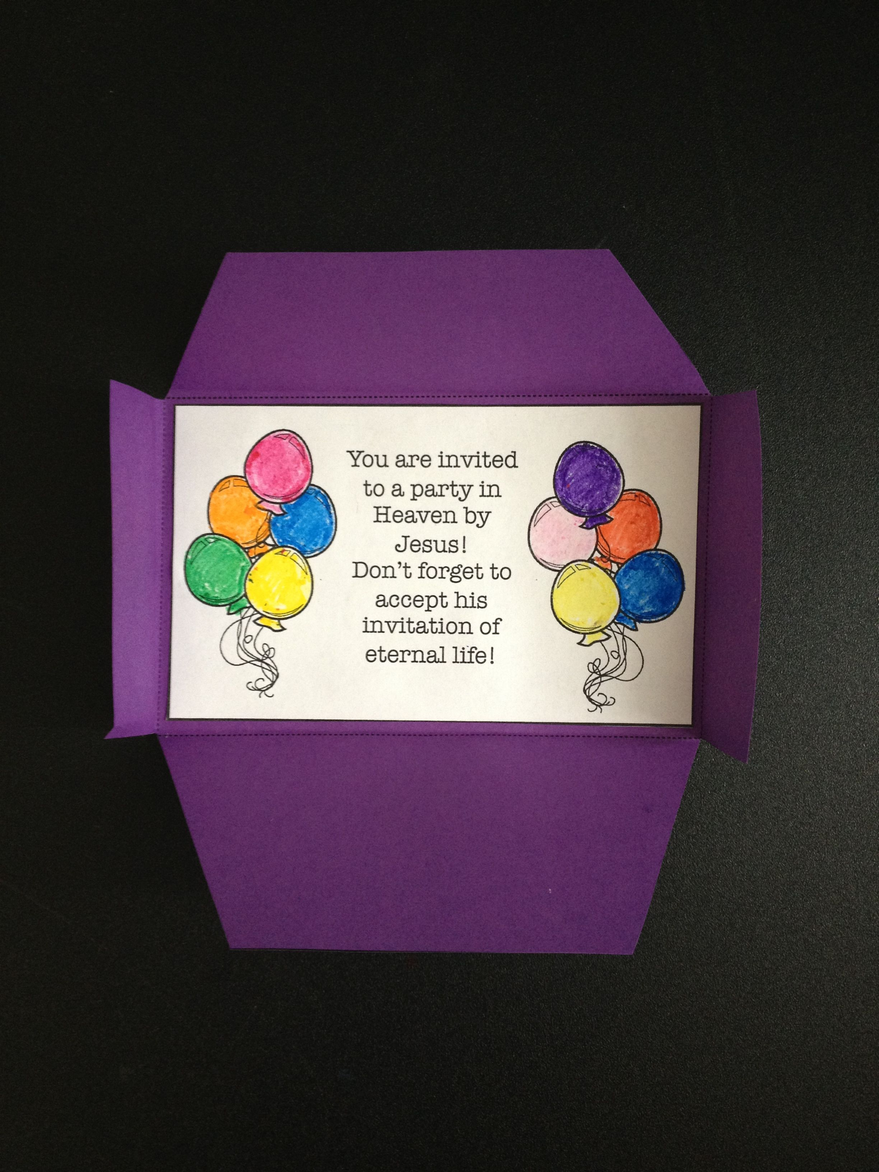

Slide 4


By answering God’s invitation to be kind, generous, forgiving and loving towards others , we can help to think about God’s kingdom here on earth. We can help other people to see that we care for everyone, no matter who they are or where they come from and because of this the world will be a better place.
What do you think God asks us to do?
How can you answer God’s invitation?
This week try to listen to what God wants from you and say ‘yes’ to His invitation by the way you behave.

Slide 5


Let us pray…
Dear Jesus,
Please help me to be kind and loving
every day.
Amen

