Slide 1
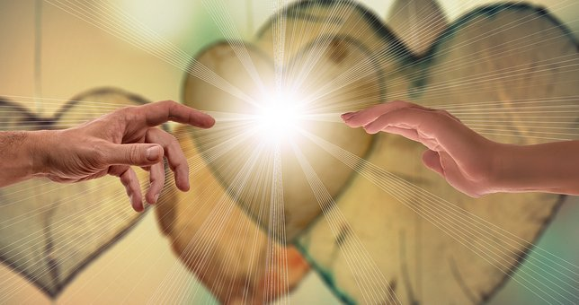
The 29th Sunday of Ordinary time
Matthew 22:15-21
Year A
‘Jesus said this to them, “Give back to Caesar the things that are Caesar’s.
And give back to God the things that are God’s.’
https://www.youtube.com/watch?v=gmm8ETk70lg

Slide 2
A Reading from the Holy Gospel According to Matthew
Then the Pharisees left the place where Jesus was teaching. They made plans to trap Jesus with a question. They sent some of their own followers and some men from the group called Herodians. These men said, “Teacher, we know that you are an honest man. We know that you teach the truth about God’s way. You are not afraid of what other people think about you. All men are the same to you. So, tell us what you think. Is it right to pay taxes to Caesar or not?”
But Jesus knew that these men were trying to trick him. So, he said, “You hypocrites! Why are you trying to trap me? Show me a coin used for paying the tax.” The men showed him a silver coin. Then Jesus asked, “Whose picture is on the coin? And whose name is written on the coin?” The men answered, “Caesar’s.”
Then Jesus said to them, “Give to Caesar the things that are Caesar’s. And give to God the things that are God’s.
Matthew 22:15-21

Slide 3
Reflection:
In this Gospel, the pharisees set a trap for Jesus. They ask Him if it’s ok to pay taxes to the Romans or not. If He says ‘yes’, then he will be a collaborator with the Jewish authorities; if He says ‘no’, He will be supporting Caesar who the Romans consider to be divine.
From his first words to them, Jesus shows that he is very much aware of what they are trying to do. He asks to see a Roman coin, a Denarius, which is readily handed to him.
Jesus shows that he is cleverer than his questioners. He responds in a way that makes them look foolish; He points to Caesar and points to the image of him which declares him as a false God. Jesus says to them ‘Give this back to Caesar… the Romans can have their coins…but as a people created by God, you must give yourselves back to God. He reminds us of what is more important.
We belong to a society preoccupied with worldly things such as money, grades, sport, popularity, food, television… but then we are tempted to neglect other things that are also important in our lives. We are also a people created by God…we can give ourselves back to God in community, in prayer and our love for one another.

Slide 4
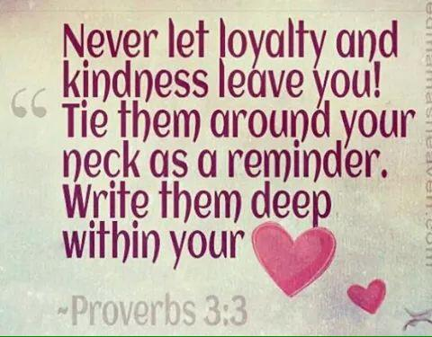
Post-it Challenge:
Think about the times when you do not give God what is due to God. Even though there are times when we are not the person that God wants us to be—when we are not loyal to God—we can always ask forgiveness and start again.
How do you show loyalty to your friends?
Are their times when you are distracted by the temptation to be ‘cool’ or ‘clever’, knowing that you are making the wrong choices?
When you are faced with choices this week, think about whether or not your decisions will honour your loyalty to God.
Remember – Your actions towards others are also your actions towards God!

Slide 5
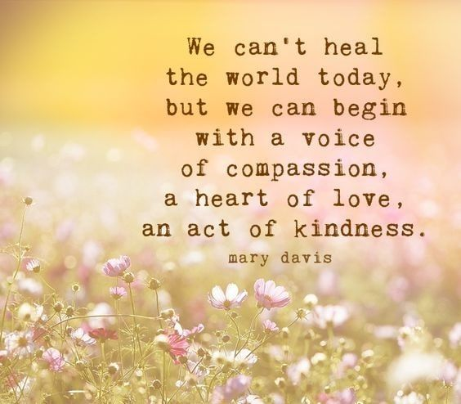
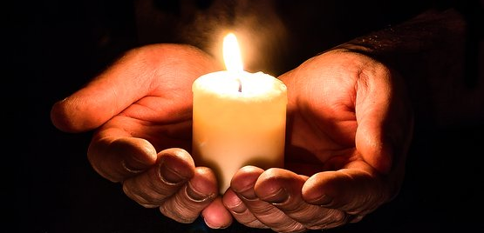
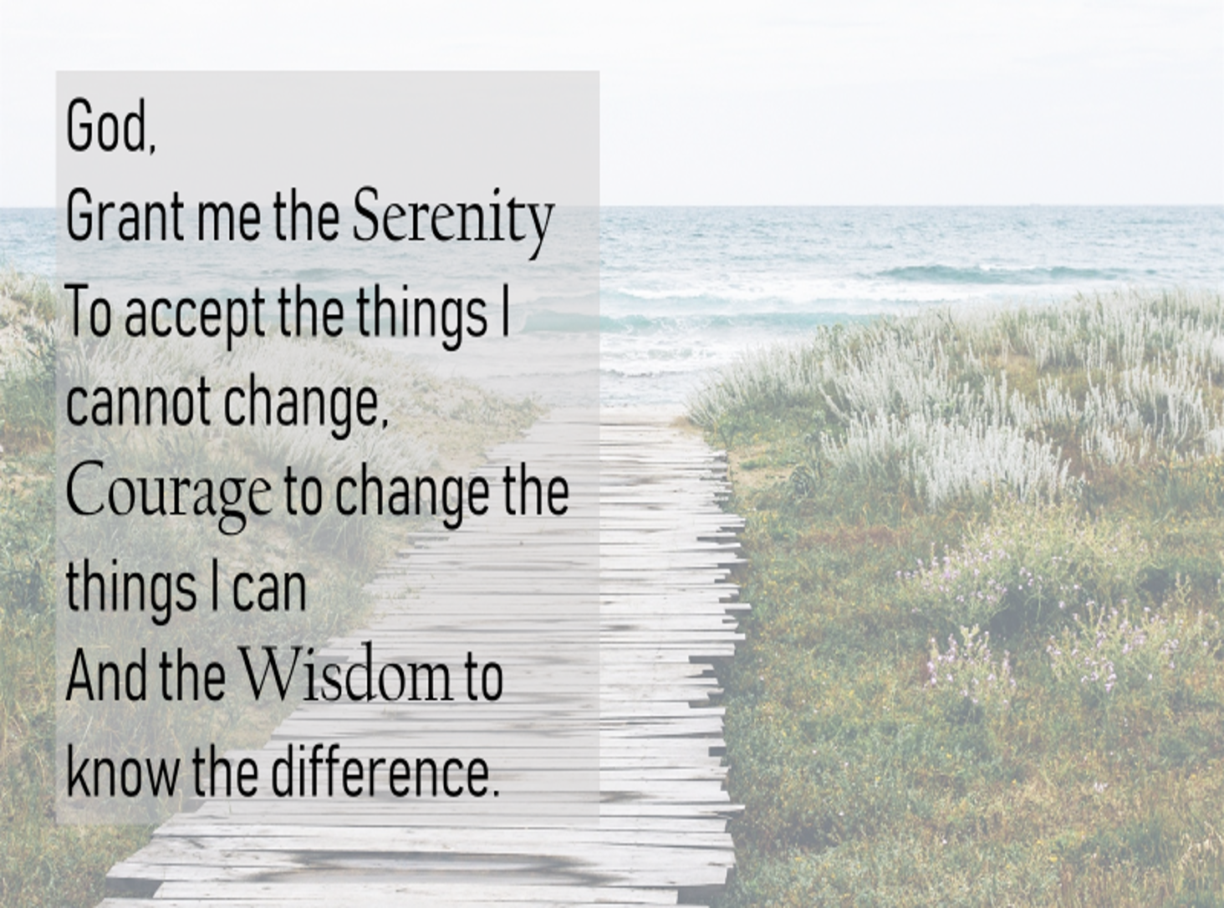
Let us Pray
Lord, you call us to love you and to care for one another.
Grant us the gifts of loyalty and kindness.
May we never forget what you ask of us and
Help us always to reach out to each other in love.
Amen.

