Slide 1

The 29th Sunday of Ordinary time
Matthew 22:1-12
Year A
https://www.youtube.com/watch?v=np-IwYpln4Q

Slide 2

A Reading from the Holy Gospel according to Matthew
The Pharisees said to Jesus, “Teacher, we know that you are an honest man. We know that you teach the truth about God’s way. You are not afraid of what other people think about you. All men are the same to you. So, tell us what you think. Is it right to pay taxes to Caesar or not?”
But Jesus knew that these men were trying to trick him.
Jesus said to them, “Give to Caesar the things that are Caesar’s. And give to God the things that are God’s.

Slide 3



When you are faced with choices this week, think about whether or not your decisions will show your loyalty to God.
Remember – Your actions towards others are also your actions towards God!
How do you show loyalty to your friends?
What can we give back to God?
What is loyalty?

Slide 4


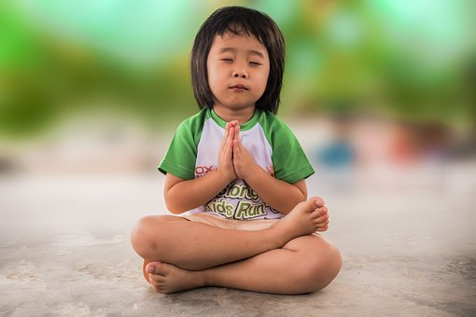
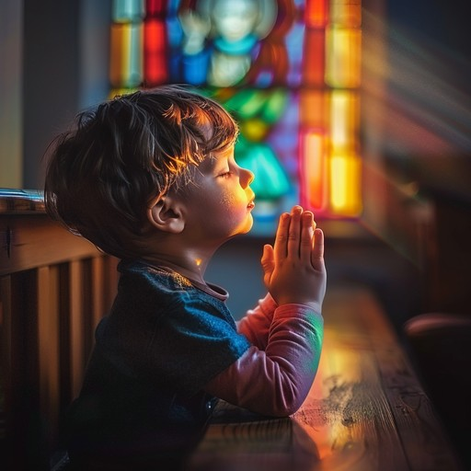
Let us pray…
Dear Jesus,
Help me to always to be loyal to my friends and reach out to others in love.
Amen

