Slide 1



Friday 13th November
L.C. Am I able to write about a picture?

Slide 2
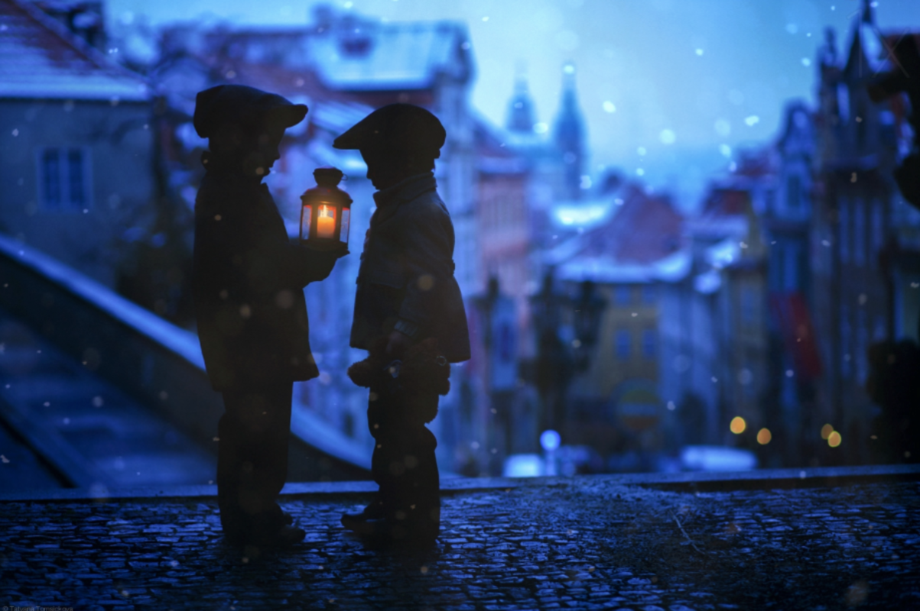
Twinkle, twinkle little flame

Slide 3

As they stood there silently in the darkness, neither of them could have imagined what would happen next. They had found the lantern by chance as they were scouring the streets looking for food. Lying on the cobbled street, waiting to be found, the lantern burnt through the dim light of evening. The boys held it in their hands, watching the orange flame flicker in the breeze.
Without warning, the flame disappeared, as did the two boys!
When the flame reappeared, the boys could not believe where they were …

Slide 4

The boys held it in their hands, watching the orange flame flicker in the breeze.
Without warning, the flame disappeared, as did the two boys!
When the flame reappeared, the boys could not believe where they were …

Slide 5
Why do the boys need the lantern?
Why are the boys out at night on their own?
What are the boys thinking about?
Where will the boys end up?
What caused the flame to go out?
Where did the lantern come from?

