Slide 1

NEGATIVE NUMBERS (IN CONTEXT)

Slide 3
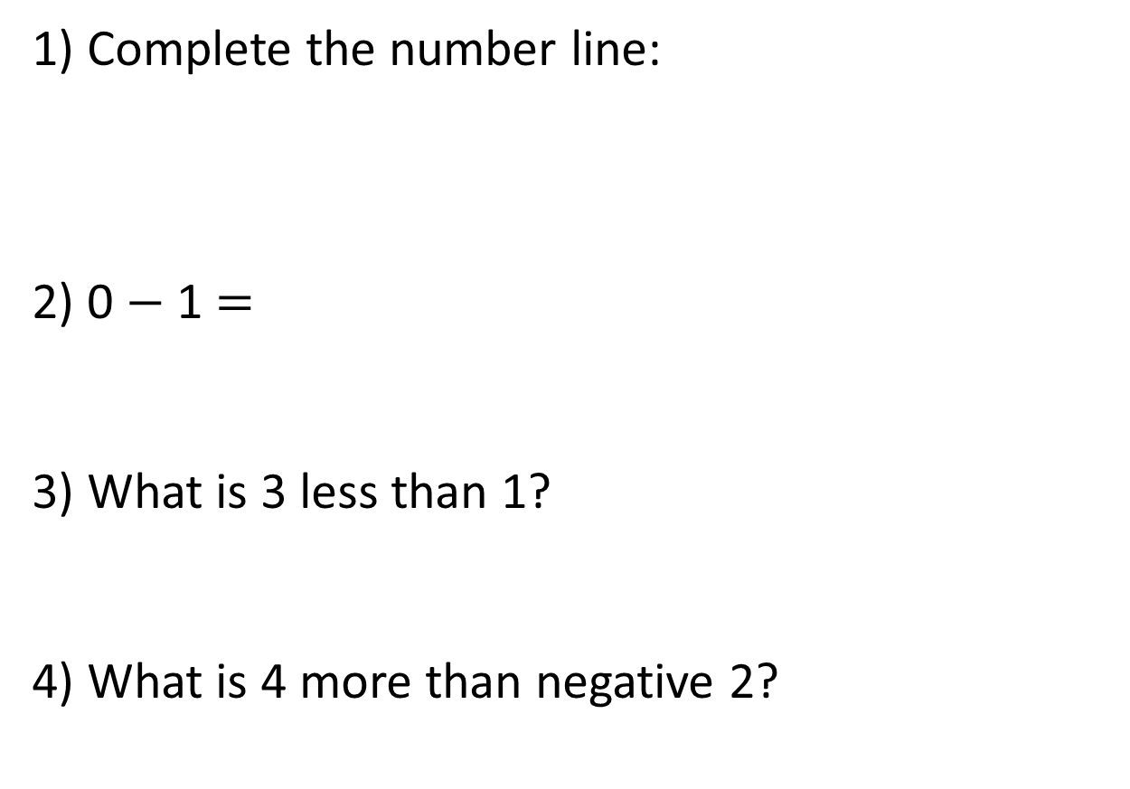
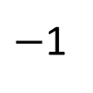
1) Complete the number line:
2) 0 $−$ 1 $=$
3) What is 3 less than 1?
4) What is 4 more than negative 2?
$−$1
0
2
3

Slide 4


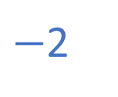
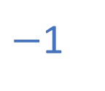
1) Complete the number line:
2) 0 $−$ 1 $=$
3) What is 3 less than 1?
4) What is 4 more than negative 2?
$−$3
$−$2
$−$1
0
1
2
3
$−$1
$−$2
2

Slide 6

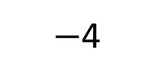
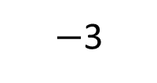
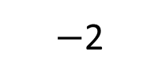
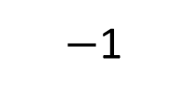
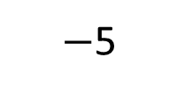
Have a think
$−$5
$−$4
$−$3
$−$2
$−$1
0
1
2
3
4
5
Where have you seen negative numbers before?

Slide 7

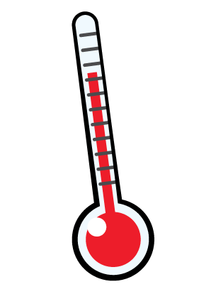
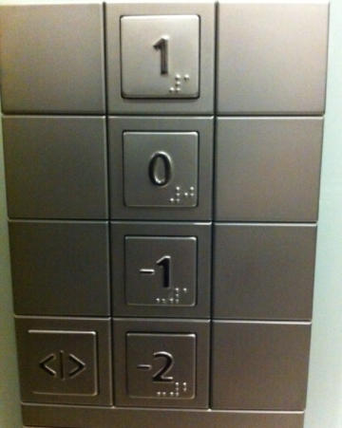

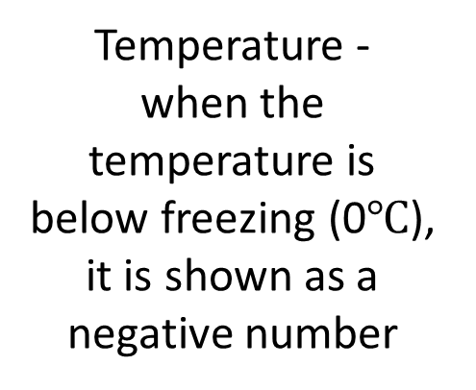
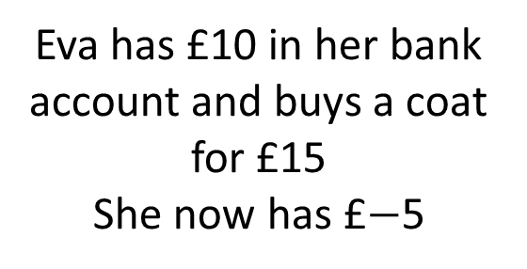
Temperature -
when the temperature is below freezing (0$℃$), it is shown as a negative number
Eva has £10 in her bank account and buys a coat for £15
She now has £$−$5
Negative numbers can be used to measure under sea level
Lift

Slide 8


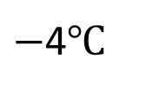
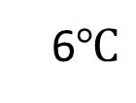
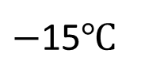
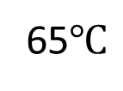
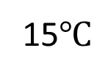
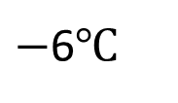
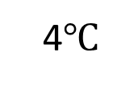
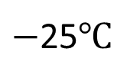
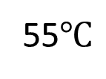
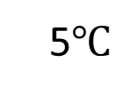
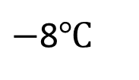
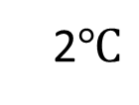
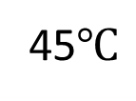
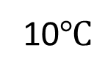
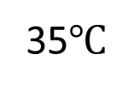
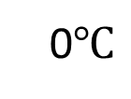
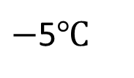
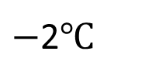
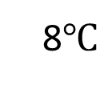
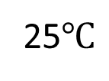
Have a think
10$℃$
65$℃$
8$℃$
55$℃$
6$℃$
45$℃$
4$℃$
35$℃$
2$℃$
25$℃$
0$℃$
15$℃$
$−$2$℃$
5$℃$
$−$4$℃$
$−$5$℃$
$−$6$℃$
$−$15$℃$
$−$8$℃$
$−$25$℃$
What’s the same and what’s different?

Slide 9


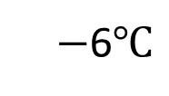
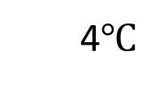
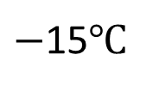
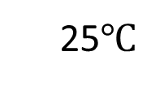
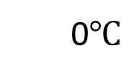
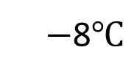
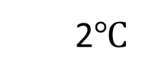
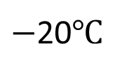
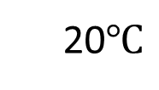
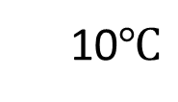
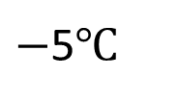

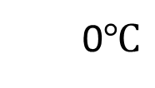
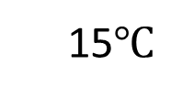
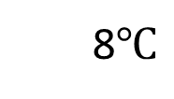
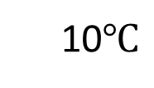
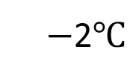
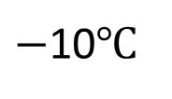




Paris
Milan
10$℃$
25$℃$
8$℃$
20$℃$
6$℃$
15$℃$
4$℃$
10$℃$
3
2$℃$
5$℃$
0$℃$
0$℃$
$−$2$℃$
$−$5$℃$
$−$4$℃$
$−$10$℃$
$−$5
$−$6$℃$
$−$15$℃$
$−$8$℃$
$−$20$℃$
Difference of 8$℃$

Slide 10













London | Chicago
9$℃$ | $−$4$℃$
How many degrees warmer is it in London?
$−$10
$−$9
$−$8
$−$7
$−$6
$−$5
$−$4
$−$3
$−$2
$−$1
0
1
2
3
4
5
6
7
8
9
10
4
9
$−$4
0
9
13$℃$ warmer in London

Slide 11




Have a think
It’s 18$℃$ inside and $−$6$℃$ outside. The difference in temperature is 12$℃$
24$℃$
6
18
$−$6
0
18

Slide 12

Look at a world map and locate different countries.
Choose a month and
research the average
temperatures for the
countries. You could use
https://en.wikipedia.org/wiki/List_of_countries_by_average_yearly_temperature
Investigate:
What do you notice about the location of countries and their temperatures?
What’s the difference between the temperature of two countries?
Which country is the coldest/hottest? How much cooler/hotter are they than the other?
Is this the same in different months?

