Slide 1
Diagonal sums investigation

Slide 2
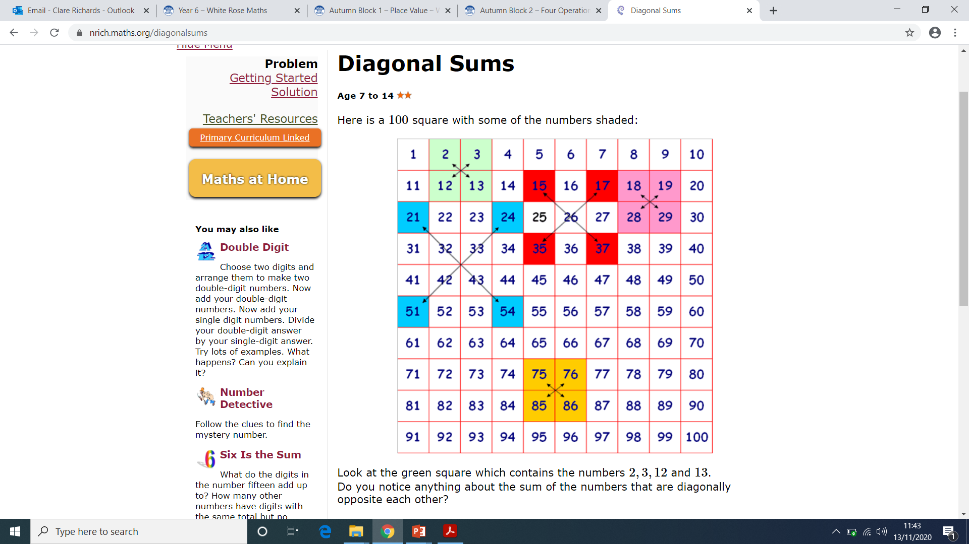

Slide 3
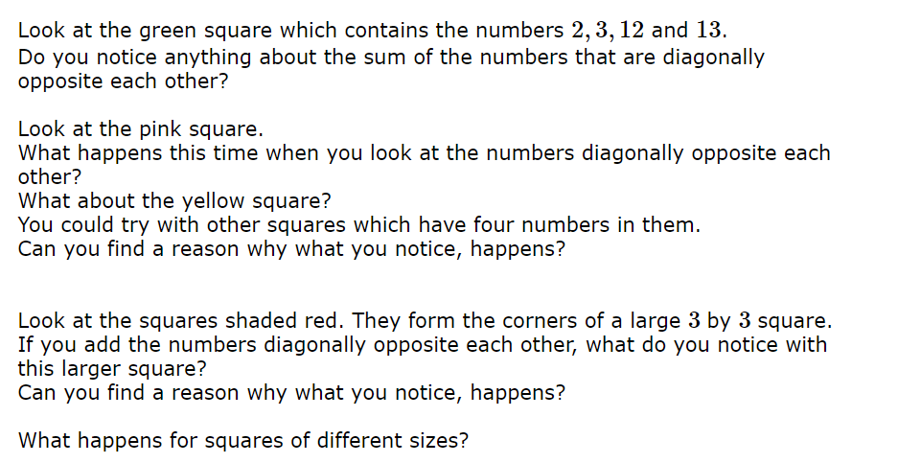

Slide 4
Write some sentences to explain what you noticed. You could use these sentence starts:
I noticed that the numbers that are diagonal to each other…
For example, …
When we add the top left and bottom right…
I have found out that…

Slide 5
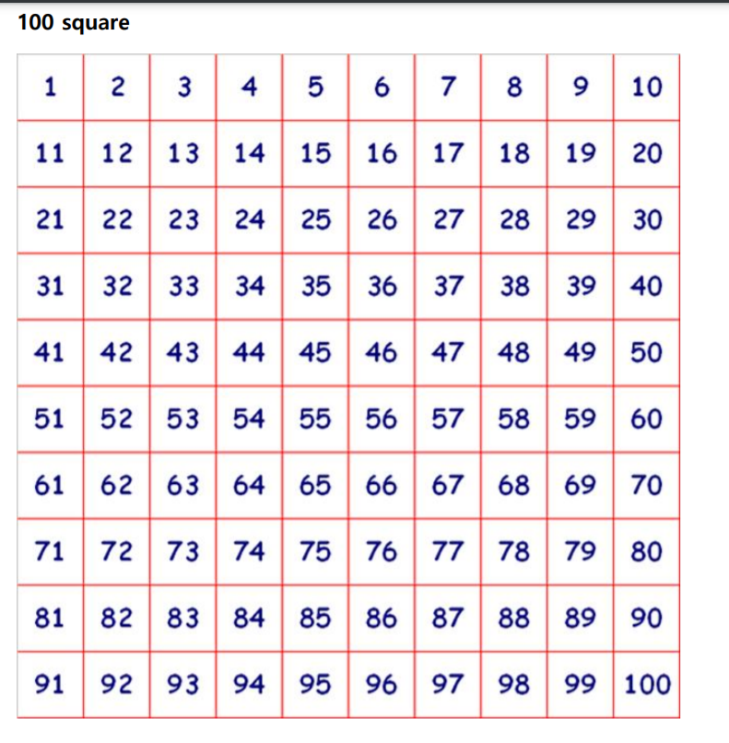
If you have a printer, you could print this off to help you investigate.

Slide 6

An explanation of the answer can be found at https://nrich.maths.org/diagonalsums%20/solution

