Slide 1
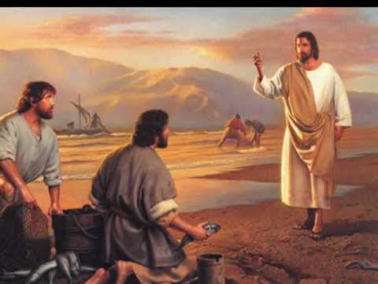
The 3rd Sunday of Ordinary time
Mark1:14-20
Year B
https://www.youtube.com/watch?v=v54IJLT171w

Slide 2

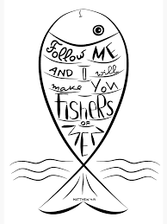
A Reading from the Holy Gospel According to Mark
As Jesus was walking along by the Sea of Galilee he saw Simon and his brother Andrew casting a net in the lake – for they were fishermen. And Jesus said to them, ‘Follow me and I will make you into fishers of men.’ And at once they left their nets and followed him.
Going on a little further, he saw James son of Zebedee and his brother John; they too were in their boat, mending their nets. He called them at once and, leaving their father Zebedee in the boat with the men he employed, they went after him.

Slide 3
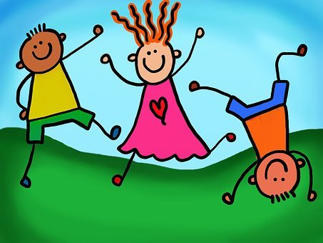

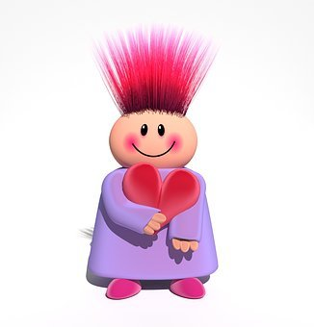
Reflection:
In this Gospel, Jesus calls the first four of his disciples in order to teach them how to ‘catch people’ rather than fish. When Jesus called his first disciples, the Gospel tells us that the fishermen (Peter and Andrew, James and John) dropped everything to follow Jesus immediately. They clearly saw something very special in this man called Jesus. It is not always easy to walk away from the things we want to do in order to do what Jesus wants us to do.

Slide 4
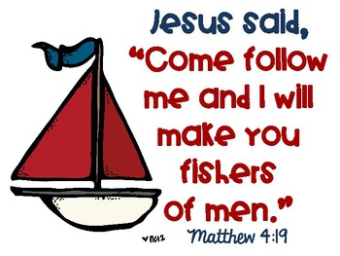

Post-it Challenge:
Jesus’ first disciples responded with absolute certainty when Jesus interrupted their daily routine and called them to a new life and to follow him.
How does God call us today?
How do we know that God is calling us?
How do we respond to the call?
What work does Jesus ask us to do?
Do we make this a priority?

Slide 5


Jesus was sent to bring the Good News, to enter the hearts of each one of us.” Pope Francis
Can you be the ‘Good News’ to those around you?
How would you feel if Jesus appeared in our school today? Would it change you in any way?

Slide 6
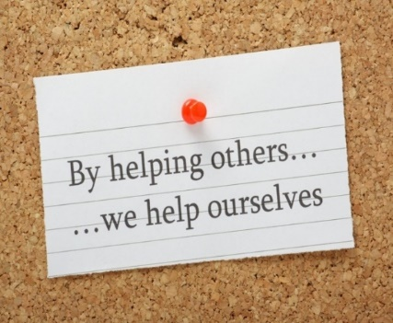
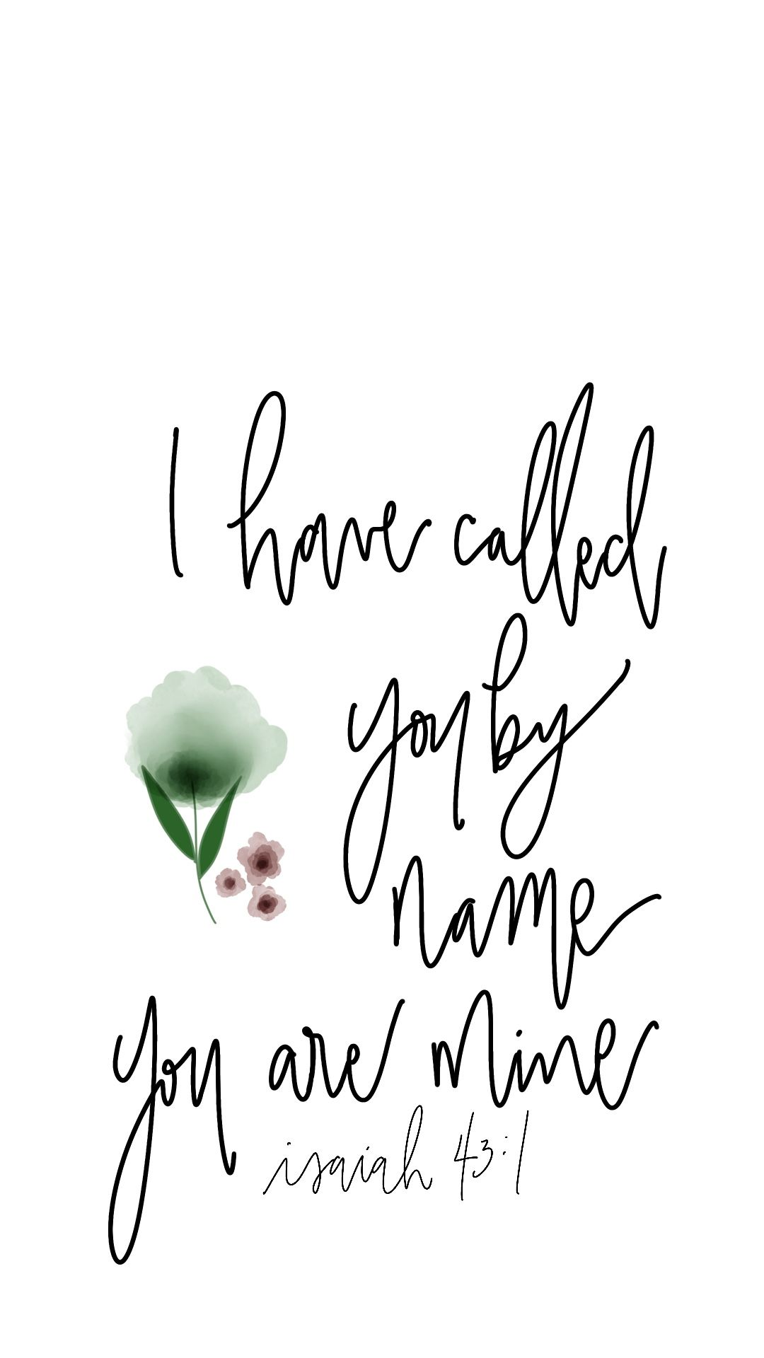
Let us pray:
Dear Jesus
You call each of us to follow you and through our words and actions to proclaim your Good News to all people.
Help us to always to follow your ways.
Amen.

